Slide 1
Deep Learning for real-time classification of astronomical radio signals
CS & Physics Meet-Up by Lamarr & B3D
Andrei Kazantsev, Yunpeng Men, Ramesh Karuppusamy, Michael Kramer
Max Planck Institute for Radio Astronomy
Bonn, Germany
November 30, 2023

Slide 2
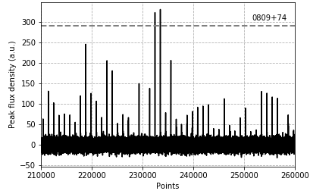
Radio astronomy
2
900 GHz
3 kHz
1 mm
100 km
Radio emission
Pulses
Continuous
© euroluftbild.de/Hans Blossey
© Ghasemi-Nodehi et al. / MPIA

Slide 3
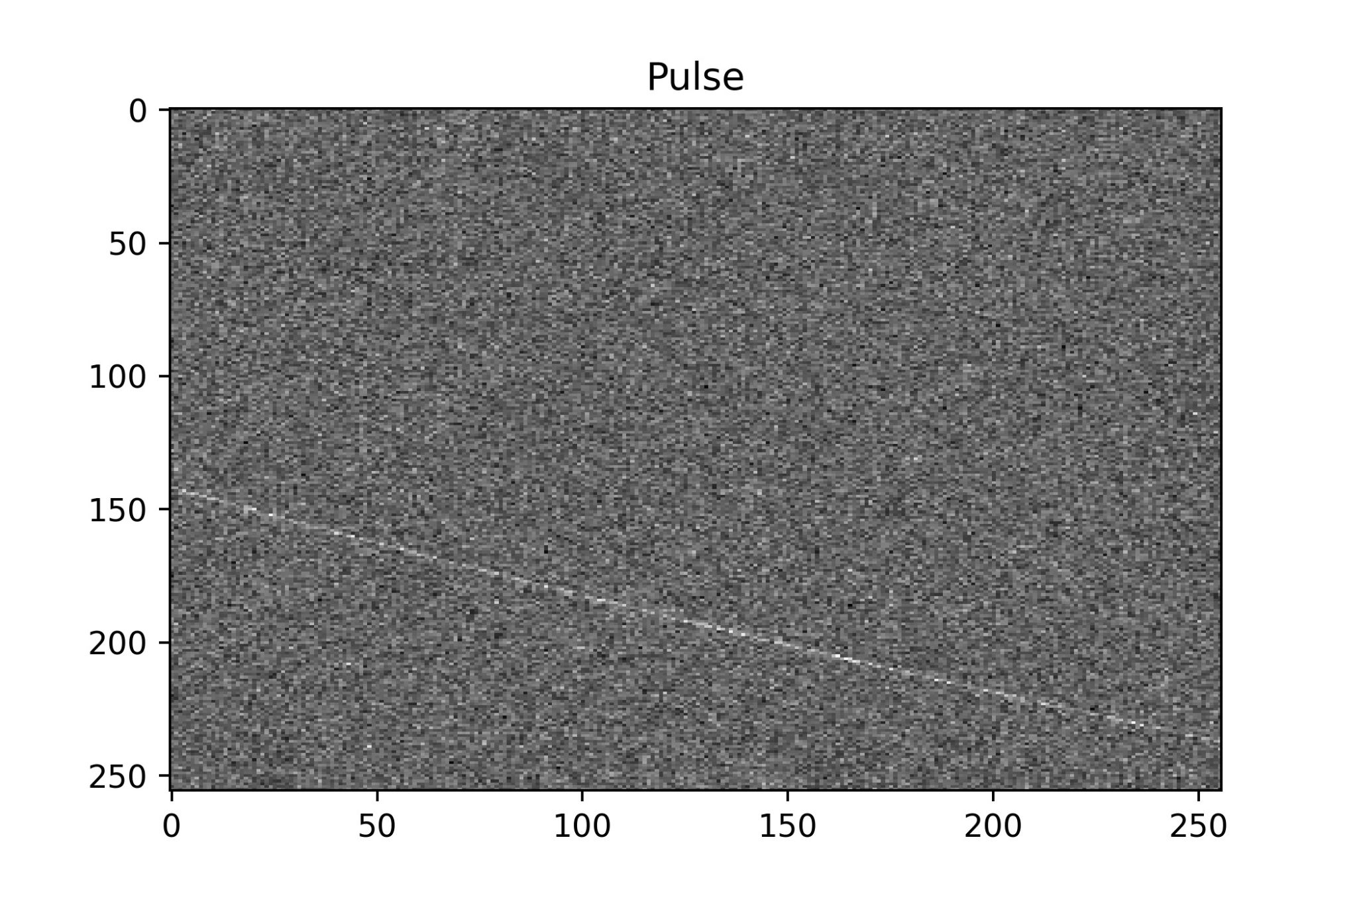
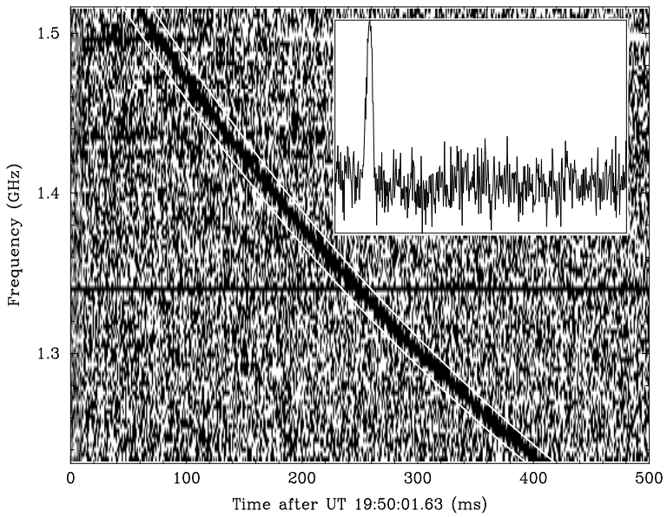
Pulsed radio emission
3
Pulsar signals show dispersion because they travel through the interstellar medium, which is filled with charged particles that affect the speed of the radio waves, causing signals of lower frequency to arrive later than those of higher frequency.
© D.R. Lorimer et al (2007)
Pulsars
Fast Radio Burst
Fast rotating neutron stars whose pulsed emission is interesting both in itself and in its application to the study of the interstellar medium and the search for gravitational waves.
Pulsed radiation, the nature of which is still not fully understood.

Slide 4
Radio astronomy - signal
4
RF Filter
Mixer
IF Amplifier
LNA
RF Amplifier
ADC
Storage
IF Filter
Local Oscillator

Slide 5
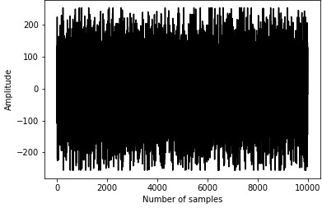
Data types in radioastronomy
5
1
Baseband data
Filterbank data
Time series
2
RF Filter
Mixer
IF Amplifier
3
ADC
LNA
RF Amplifier
IF Filter
Storage
Local Oscillator

Slide 6
Data types in radioastronomy
6
1
Baseband data
Filterbank data
Time series
2
The stream of voltage data from a radio telescope. The most detailed data format.
3
ADC
Storage

Slide 7
Data types in radioastronomy
7
1
Baseband data
Filterbank data
Time series
2
A spectrogram obtained by Fourier transforming baseband data.
3
ADC
Storage

Slide 8
Data types in radioastronomy
8
1
Baseband data
Filterbank data
Time series
2
The sequence of pulsar pulses that has been dedispersed and summed across frequency channels.
3
ADC
Storage

Slide 9
Data types in radioastronomy
9
1
Baseband data (size)
Filterbank data (size)
Integrated profiles (size)
2
3
ADC
Storage

Slide 10
The aim…
10
1
Real-time classification of radio telescope signals and storage of dispersed signals in baseband format.
2
3
ADC
Storage

Slide 11
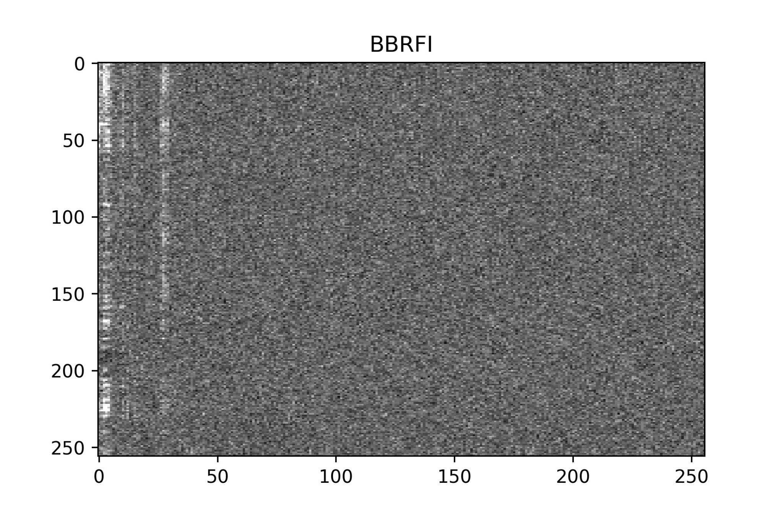
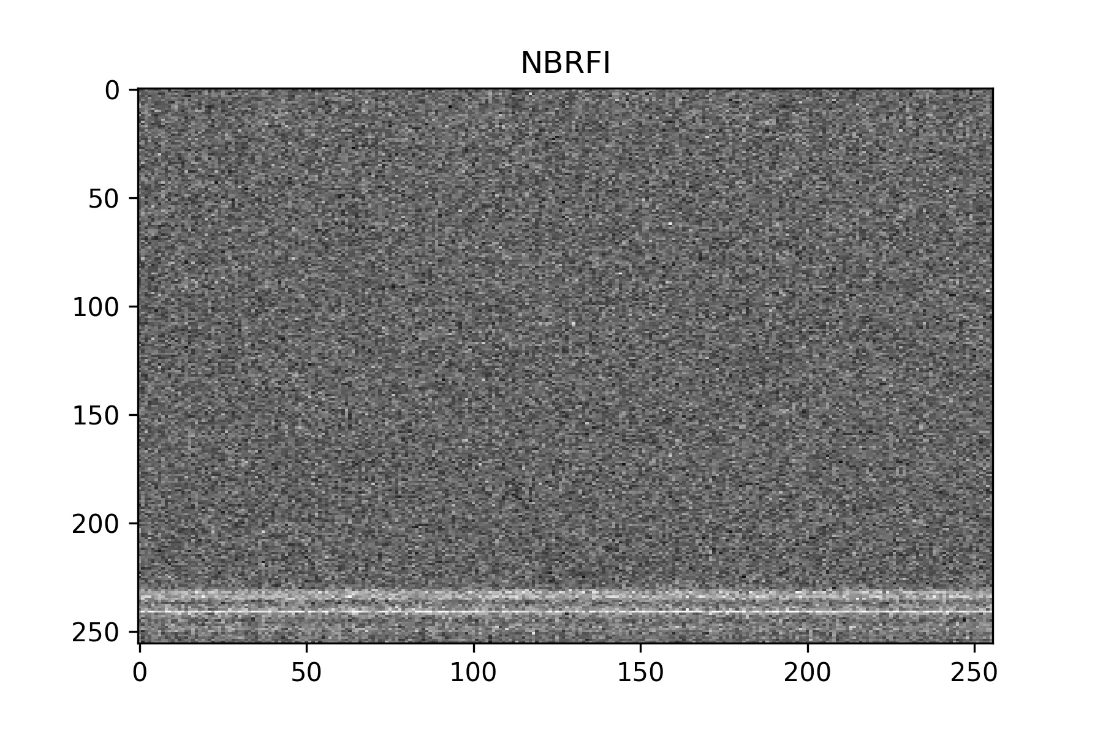
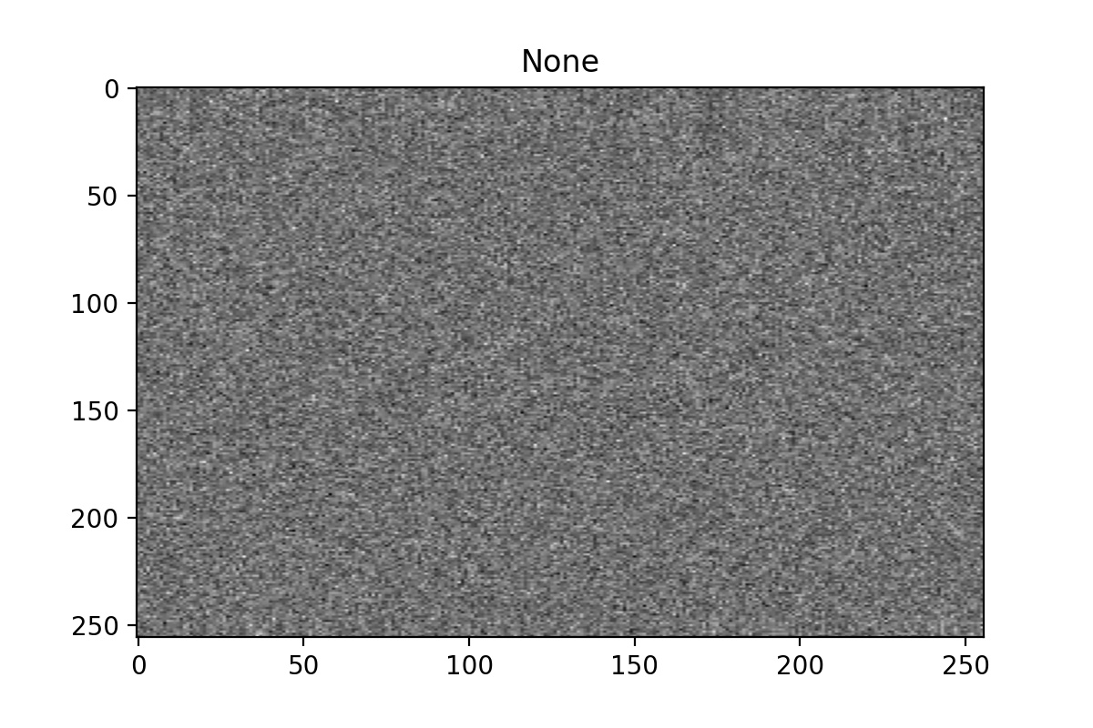
The idea
11
1
The model receives data from the telescope in real time
2
3
ADC
Storage

Slide 12
The idea
12
1
If there is a signal with dispersion in the analyzed data section, it is saved in baseband format.
2
3
ADC
Storage

Slide 13
The idea
13
1
For other signals, they are stored according to the observation program
2
3
ADC
Storage

Slide 14
The idea
14
1
It is assumed that previously stored signals are used to retrain the model
2
3
ADC
Storage

Slide 15
Model requirements - 1
15
256 frequency channels
The time of decision-making should be less than the time of receiving the processed portion of data
256 time samples of 64 microseconds each
16.4 milliseconds
ADC
Storage

Slide 16
Model requirements - 2
16
If accuracy == 90%:
The model should be very accurate, so as not to create false triggers and not to load the server with useless data.
Than useless data rate == 10%
For SKA telescope it is 204 GB /s
ADC
Storage

Slide 17
The model – our idea
17
The project's goal is to classify signals received by a radio telescope in real-time.
If the classified signal exhibits dispersion delay, this segment of data should be saved in the most detailed format possible.
Classification must occur faster than the time it takes to receive the data segment being classified.
The classification should be highly accurate to avoid storing large amounts of unnecessary information.
ADC
Storage
High accuracy
Fast decision making

Slide 18
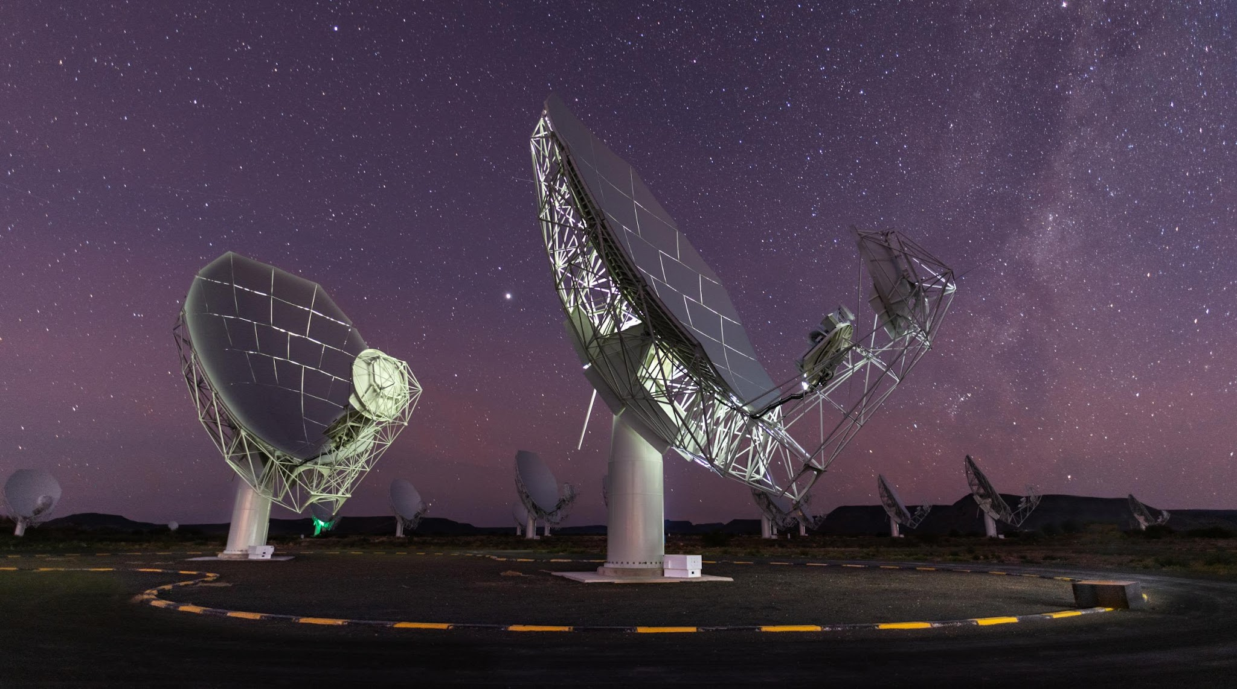
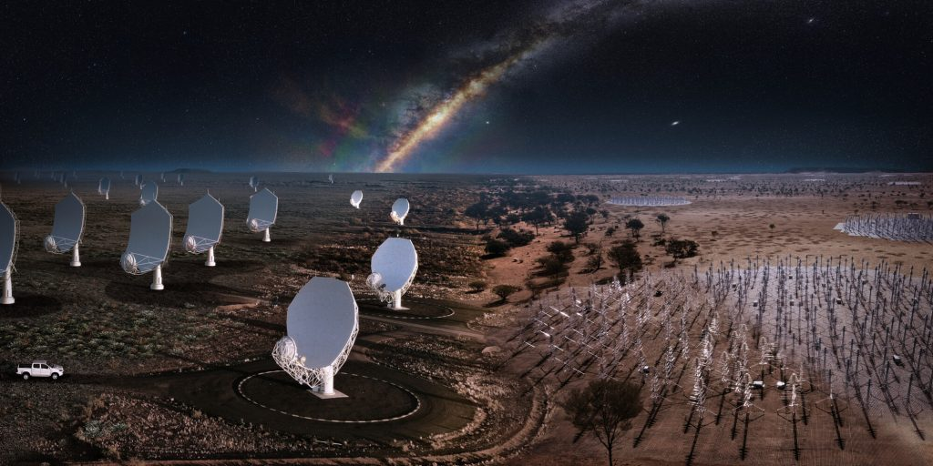
Radio telescopes and data rates
18
Radio telescope name | Radio telescope exterior | Bitrate per beam | Total bitrate
Effelsberg |  | P210-7: 11.04 Gb /s | 77 Gb / s (7)
 |  | UWB: 290 Gb / s | 290 Gb / s (1)
MeerKAT |  | 107 Mb / s | 0.1 Tb / s (~1024 beams)
Square Kilometer Array |  | ~ 1 Gb / s | 20 Tb / s (>2200 beams)

