Slide 1
Potential ML applications to accelerate ISM simulations - CS & Physics Meet-Up by Lamarr & B3D
NGC 3324 in Carina Nebula
Credit: NASA, ESA, CSA, and STScI
Tim-Eric Rathjen
University of Cologne

Slide 2
The simulated interstellar medium
The SILCC Project (Walch et al., 2015 ... Rathjen et al., 2023)
MHD AMR code FLASH 4.6 (Fryxell et al., 2000)
Galactic patch simulation of a stratified disk in an elongated box ($0.5×0.5×±4 kpc^{3}$)
Self-gravity (Wünsch et al., 2018)
Non-equilibrium chemistry with cooling and heating (Nelson & Langer 1997, Glover & Mac Low, 2007)
Self-consistent star formation via sink particle approach (Gatto et al., 2016, Dinnbier et al., 2020)
Major stellar feedback processes
Stellar winds (Gatto et al., 2016)
Radiative transfer for EUV photons (TreeRay, Wünsch et al., 2021)
Core-collapse supernovae (Gatto et al., 2015)
Acceleration and anisotropic transport of cosmic rays in the advection-diffusion limit (Girichidis et al., 2018, Rathjen et al., 2021)
(https://hera.ph1.uni-koeln.de/~silcc/)

Slide 3
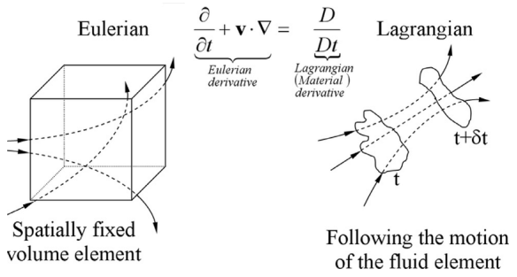
Die eulersche Gleichungen (Magneto-) Hydrodynamik
LHA 120-N11
Credit: NASA, ESA, Hubble; Josh Lake
Dichte, $ρ$, Zeit, $t$, Geschwindigkeit, $\text{v}$, Druck, $P$, Gravitationskraft, $g$,
magnetische Leitfähigkeit, $μ_{0}$, Magnetfeld, $B$, Energie, $E$, magnetische Diffusion, $η$, Wärmefluss, q
Sampath et al., 2016
Massenerhaltung
Impulserhaltung
Energieerhaltung
Induktionsgleichung

Slide 4
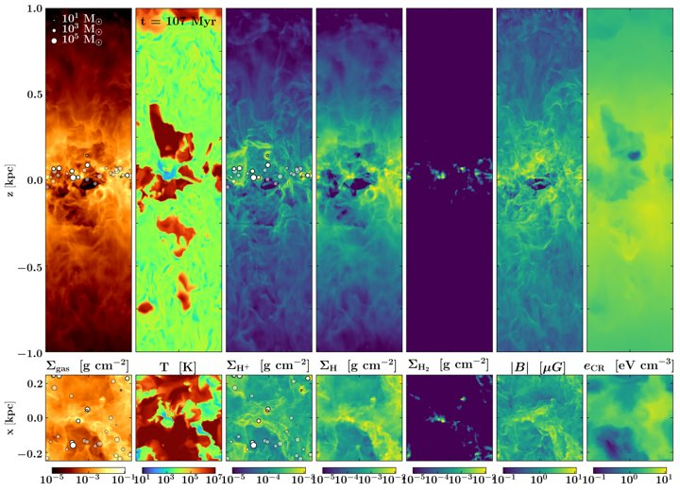
The simulated interstellar medium
One simulation takes:
~ 10^6 CPU-h
~ 1 TB storage
Most optimal scaling when run on ~ 600 cores
Bottlenecks are:
MHD sweep: ~25 %
Gravity tree + radiation: ~50 %
Chemistry (only H and C): ~10 %
Cosmic Rays: ~10 %
Rathjen et al., 2023, MNRAS, 522, 1843
https://doi.org/10.1093/mnras/stad1104

Slide 6
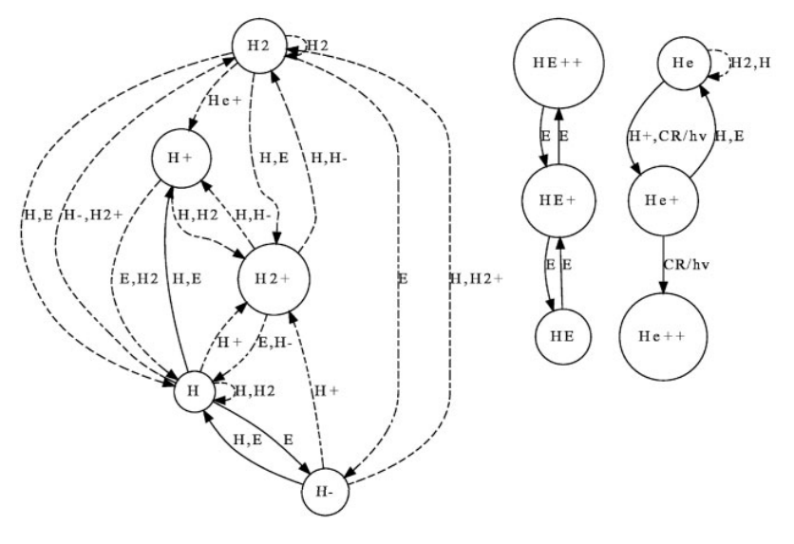
Problem: chemical networks are complex (typically more than 100 reactions) with very short evolutionary time-scales (~ 10^4 times shorter than ISM dynamical time)
Solution is strongly non-linear -> not all transition rate equations are important
Physics Informed Neural Network (PINN) to replace traditional ODE time integrators
Caveat: So far only successful for networks with complexity up to molecular hydrogen

Slide 7
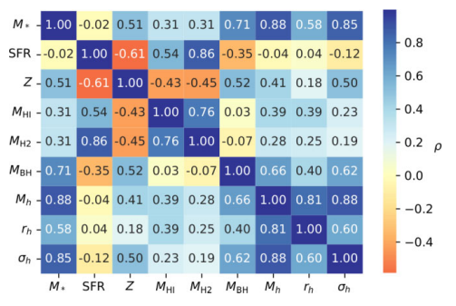
Cosmological simulations lack resolution to resolve most baryonic processes and properties like chemistry, star formation and stellar feedback
PINN trained on a set of zoom-in cosmological simulations
“Inpainting” of baryonic physics on large-scale simulations
(Very dangerous)

Slide 8
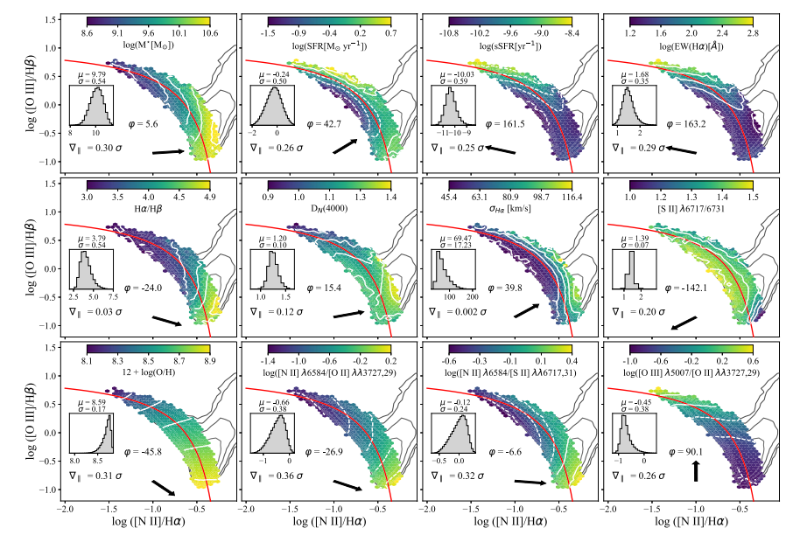
Strongly non-linear and highly degenerate parameter space
Neural networks and Random Forest classification/regression to identify the parameter(s) with the highest impact on given observable.

