Slide 1
—
Introduction of the research area of Human-Centred Systems
Prof. Dr. Natalia Andrienko

Slide 2
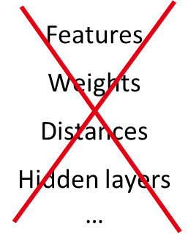
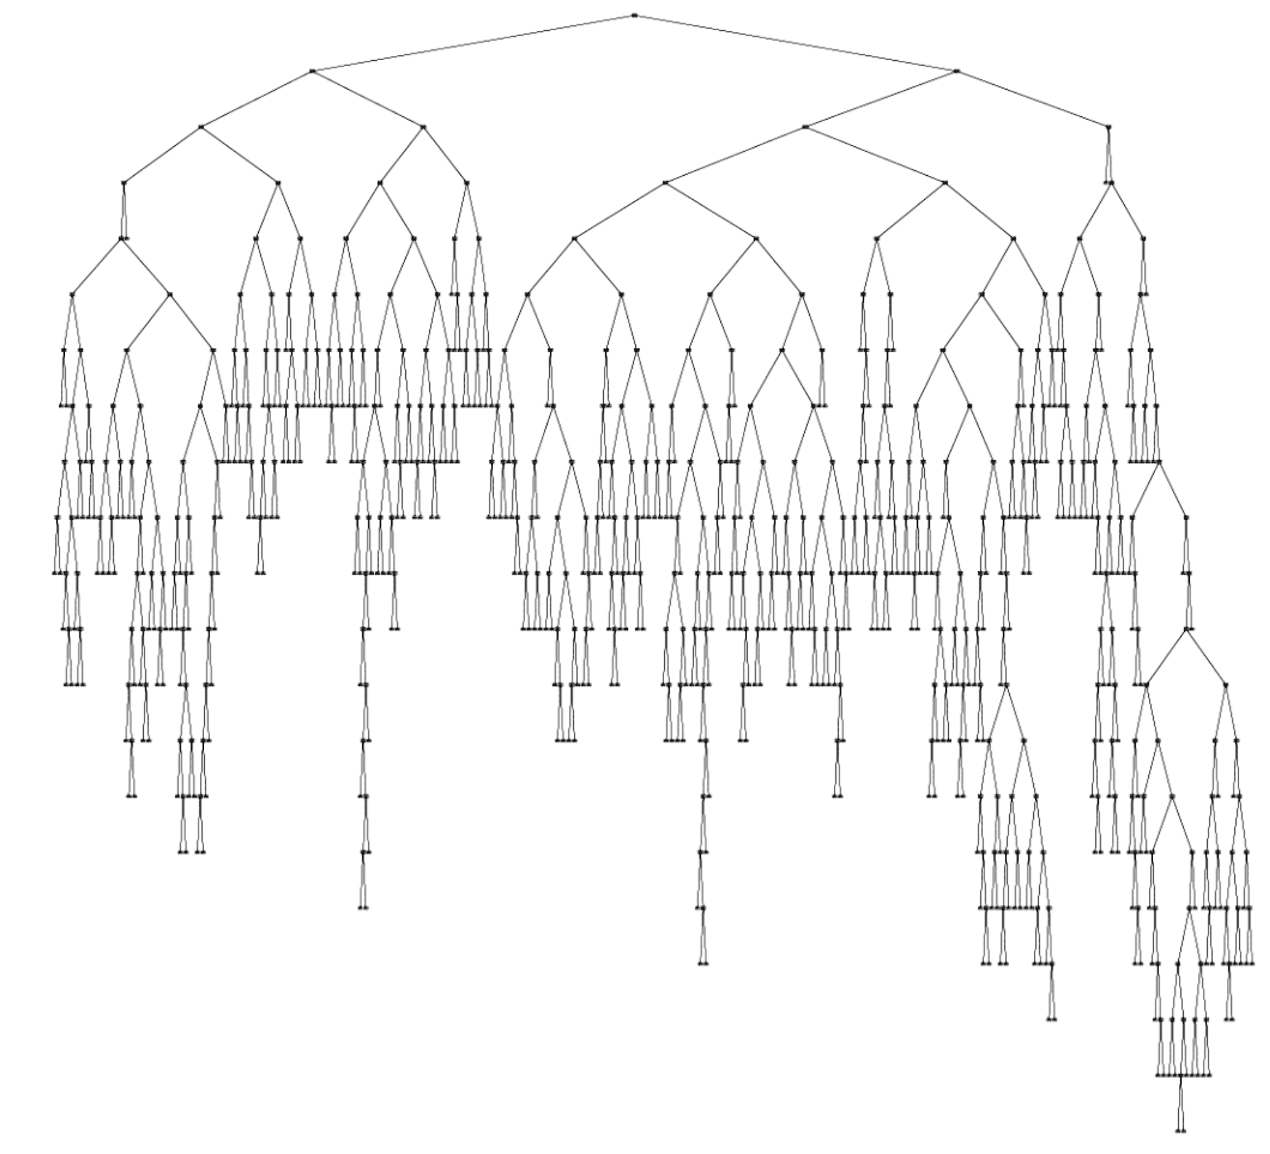
Motivation
Deficiencies of current xAI
Humans need
conceptual mismatch between explanations and human knowledge:
Data-derived “explainable” ML models are not linked to domain concepts, theories, and causal reasoning
ignorance of human perceptual and cognitive capabilities
Domain-relevant concepts
Causal relationships
Appropriate levels of abstraction
* Holzinger A, Langs G, Denk H, Zatloukal K, Müller H. Causability and explainability of artificial intelligence in medicine. Wiley Interdiscip Rev Data Min Knowl Discov. 2019, 9(4):e1312

Slide 3
Concept definition
Two sides of human-centredness:
Computers adapt to human goals, concepts, values, and ways of thinking.
Computers take advantages of the power of human perception and intelligence.
Two key components of a human-centred AI system:
Human-oriented Al – approaches involving algorithmic solutions for explainability and trustworthiness
Approaches supporting AI-Human communication and collaboration

Slide 4
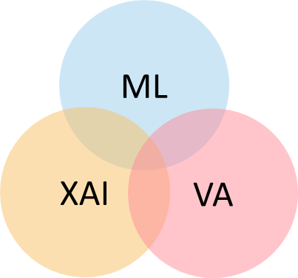
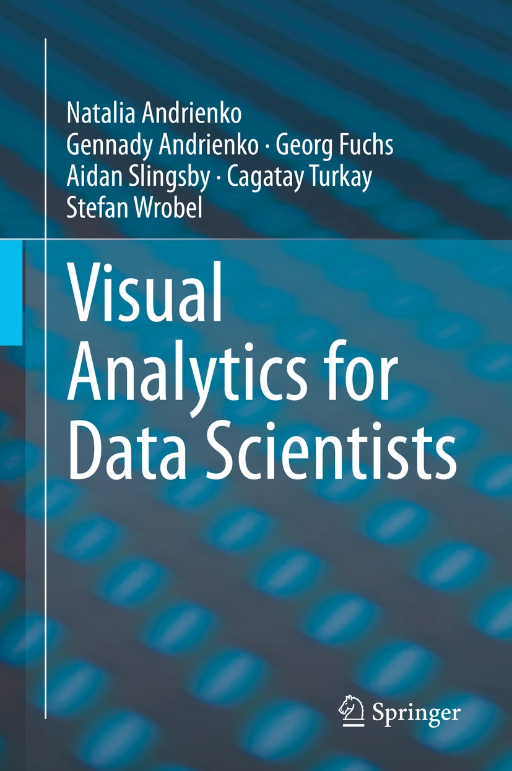
Synergy of research disciplines
Human-centered systems ← ML + XAI + visual analytics
Objective
Approach
Data
Context
knowledge
ML
directions
Human
explanations
Combine human and computer intelligence:
Humans for ML: make better use of human intellectual capabilities in developing ML models
ML for humans: ensure that ML models are properly explained to humans in terms of human-relevant concepts
Develop interactive visual interfaces as
means of human-computer communication
facilitators of human understanding
triggers of human abstractive perception and thinking

Slide 5
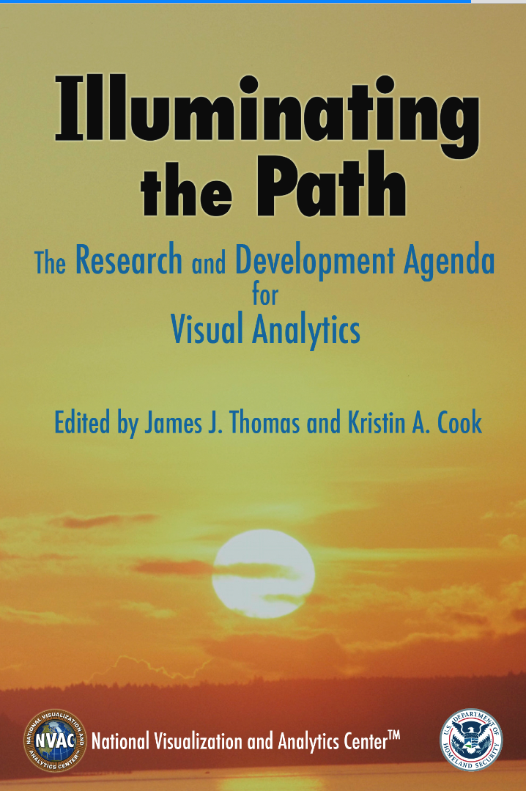
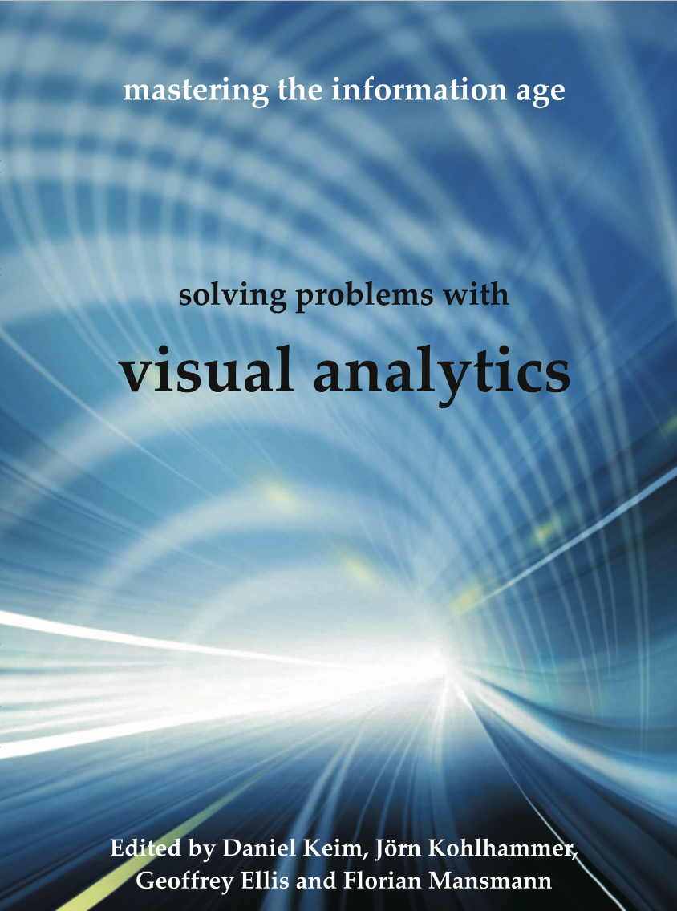
Visual Analytics
“The science of analytical reasoning facilitated by interactive visual interfaces”
Visualisation
Interaction
Visual mapping
Cognition
Visual mapping
Data
😐
Knowledge
Perception
Transformation
Analysis
Descriptors, patterns, models, ...
Refinement
Computational processing
Controlling

Slide 6
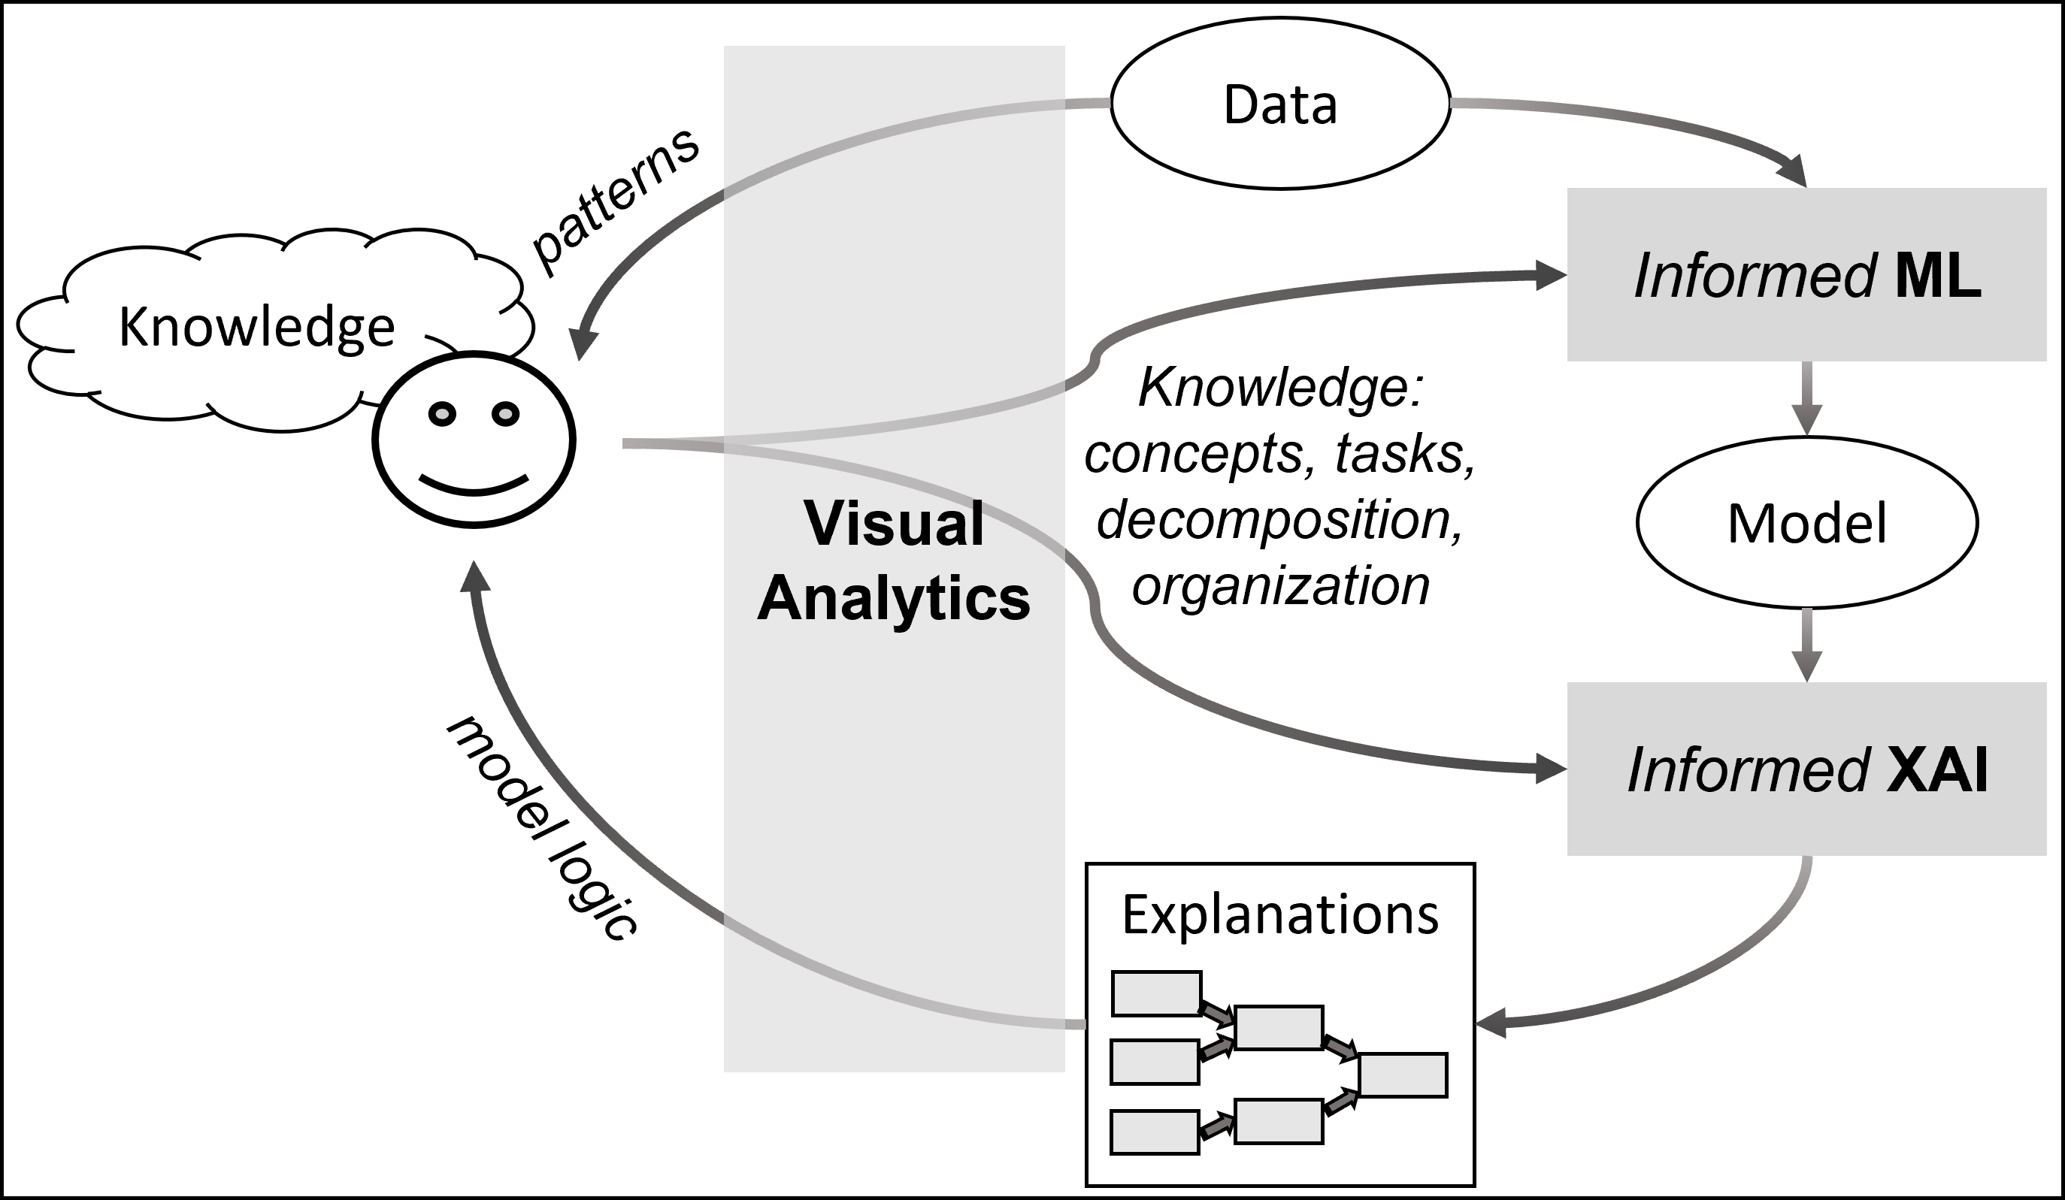
Ideas for HCAI powered by VA
Main goal: enable synergy of human and machine intelligence
Learn from experts:
domain concepts and logic, causal relationships, ways to explain
Facilitate model utilisation and adoption:
user-oriented presentation and explanation of model work and results
Support collaborative human-AI problem solving and decision making:
partnership and complementary contributions; discourse and mixed initiative
Facilitated by Visual Analytics
N. Andrienko, G. Andrienko, L. Adilova and S. Wrobel, "Visual Analytics for Human-Centered Machine Learning," in IEEE Computer Graphics and Applications, vol. 42, no. 1, pp. 123-133, 1 Jan.-Feb. 2022, doi: 10.1109/MCG.2021.3130314.

Slide 7
Our recent and ongoing works

Slide 8
Enabling interactive visual exploration of model’s work
Our recent and ongoing works

Slide 9
Problem statement
Enabling interactive visual exploration of model’s work
Given: a model doing job schedule optimisation ( solving job shop scheduling problem)
Our task
Application: flight scheduling in civil aviation
Flight plan (= job): a sequence of traversed airspace sectors (= machines) with entry and exit times
Sectors have limited capacities; overloads are dangerous and must be avoided
The model iteratively shifts the departure times of selected flights with the aim to eliminate any overloads (“hot spots”)

Slide 10
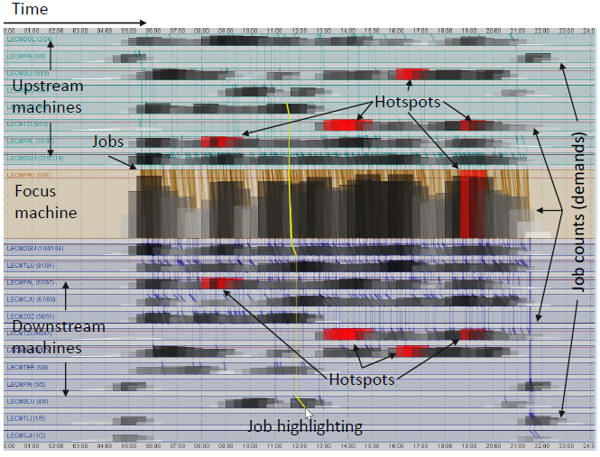
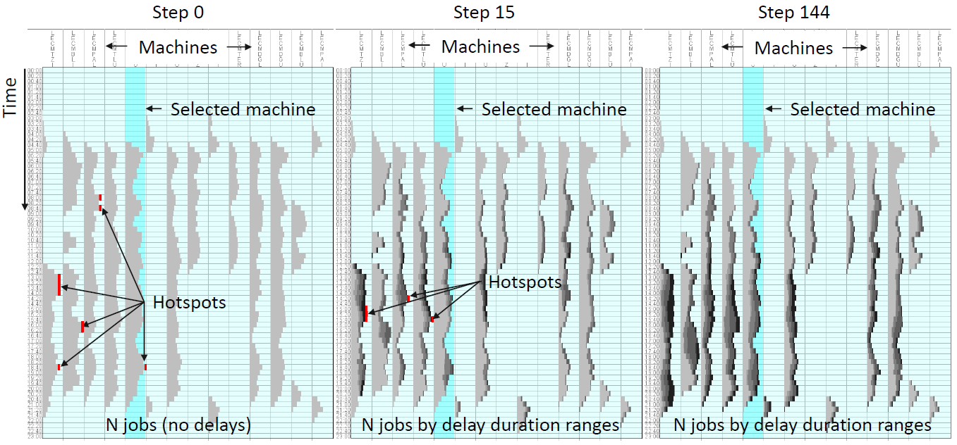
Enabling interactive visual exploration of model’s work
Facilitating model utilisation and adoption
Process overview
Timetable exploration
Comparison of selected versions of the schedule
G. Andrienko, N. Andrienko, J. M. C. Garcia, D. Hecker and G. A. Vouros, "Supporting Visual Exploration of Iterative Job Scheduling," in IEEE Computer Graphics and Applications, vol. 42, no. 3, pp. 74-86, May-June 2022, doi: 10.1109/MCG.2022.3163437.

Slide 11
Summary
Enabling interactive visual exploration of model’s work
Interactive visualisation enables model developers to examine the behaviour of the model.
It can also help users understand how the model works and why it produces a particular result.
Visualisations present information at different levels of abstraction.
Presentation of the information is decomposed into multiple views showing different aspects and relationships.

Slide 12
Explaining rule-based model’s logic using a simplified descriptive model
Our recent and ongoing works

Slide 13
Problem statement
Explaining rule-based model’s logic using a simplified descriptive model
Given: a rule-based model with a large number of decision rules
It can be a mimic model intended to “explain” a black box
A model in the form of decision tree can be transformed to an equivalent system of decision rules
Task: facilitate human’s comprehension of the logic of the entire model
Challenge: although decision rules and decision trees are considered “inherently interpretable”, comprehension of a large system of rules or decision tree may be beyond human perceptual and cognitive capacity.
Aspects of complexity:
Number of rules
Number of conditions in a rule

Slide 14
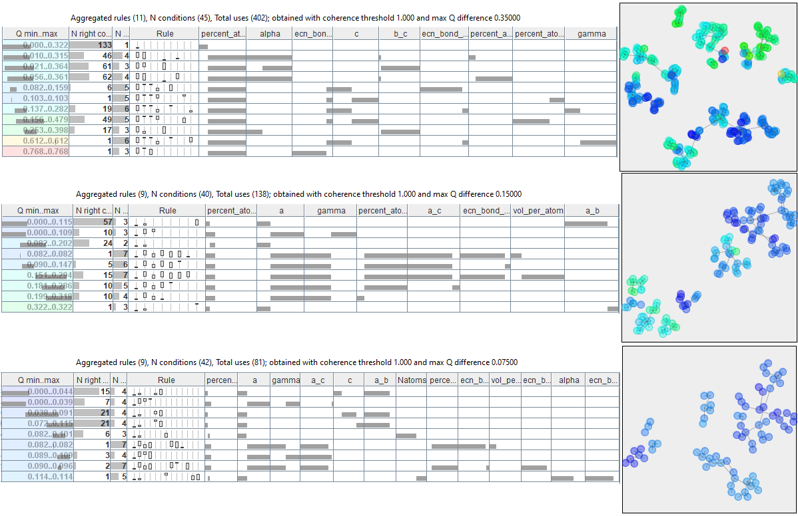
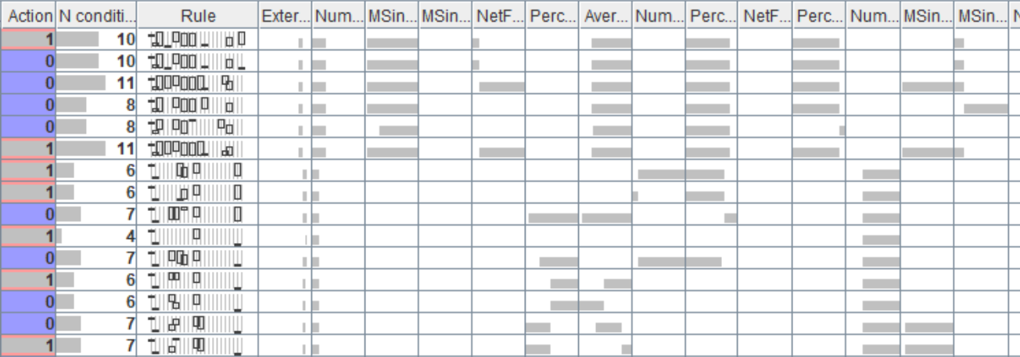
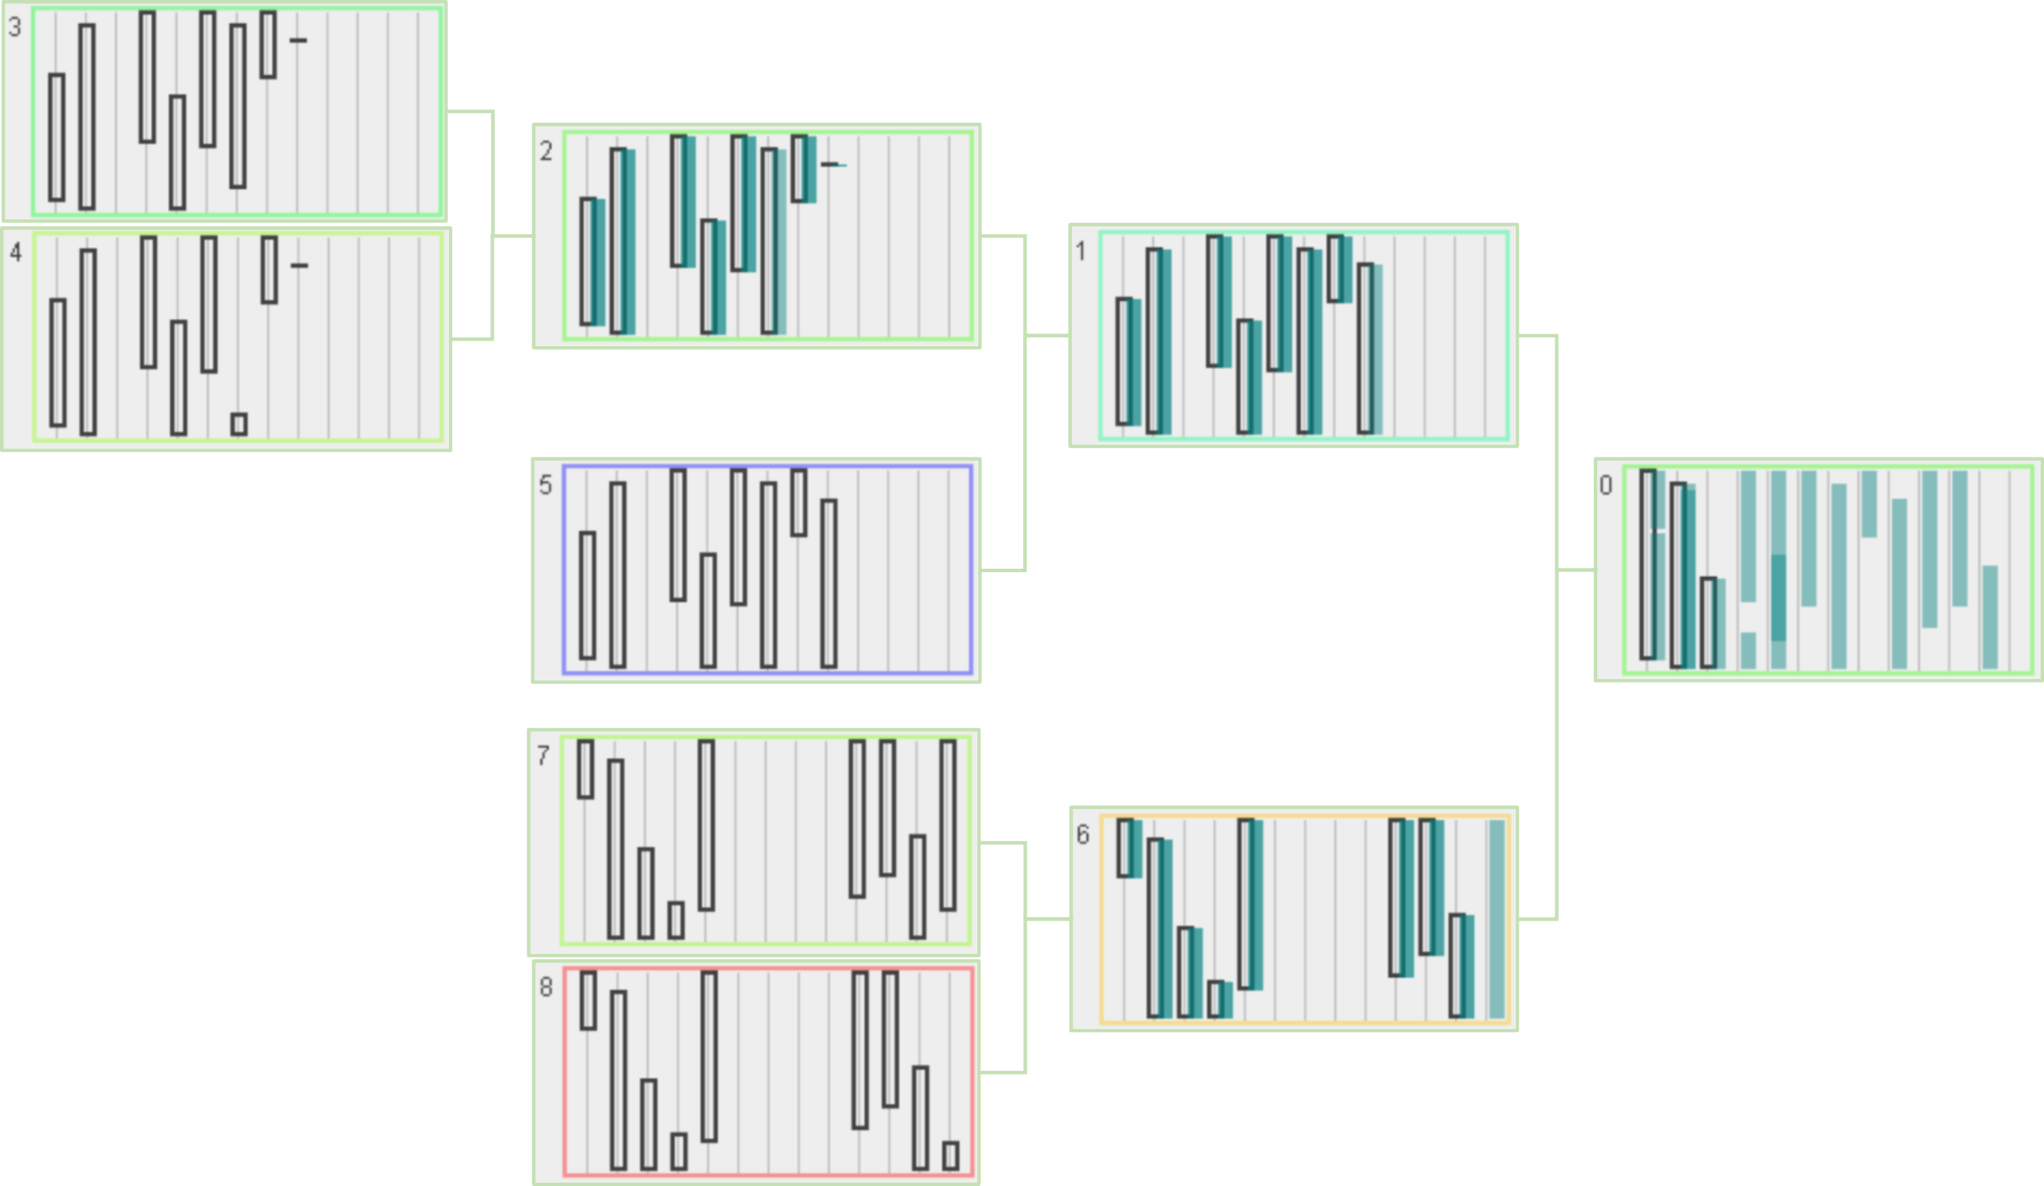
Explaining rule-based model’s logic using a simplified descriptive model
Facilitating model utilisation and adoption
Visualisation of a rule-based model
Progressive refinement of the descriptive model
Key idea: explain a complex model through a simpler descriptive model obtained by aggregating and generalising similar rules
Joining, generalising, and hierarchically organising rules
Adilova, L., Kamp, M., Andrienko, G. and Andrienko, N. “Re-interpreting rules interpretability”. International Journal of Data Science and Analytics (2023). doi:10.1007/s41060-023-00398-5.

Slide 15
Summary
Explaining rule-based model’s logic using a simplified descriptive model
Motivation: practical incomprehensibility of theoretically interpretable models due to large size and complexity
Goal: facilitate comprehension by creating a smaller and simpler descriptive model
Approach: iterative aggregation and generalisation
Rough rules with exceptions
Approximate rules for representing regression models
Limited degree of simplification for models optimised for compactness
Required: domain semantics-based grouping and aggregation of features

Slide 16
Using VA to enhance recognition of complex movement patterns
Our recent and ongoing works

Slide 17
Problem
Recognition of complex movement patterns
Representing domain concepts by machine-oriented specifications requires introducing parameters and/or thresholds.
There are usually no strict thresholds and obvious parameter choices.
Definitions or rules acquired from domain experts are often approximate and fuzzy, while machine-oriented specifications are treated as precise.
While movement behaviours occur on intervals, conditions of formal specifications are checked point-wise.
Instantaneous disruptions in fulfilment of conditions lead to patterns being missed.

Slide 18
Key idea: temporal abstraction
Instant attribute values → interval-based behaviour characteristics
Domain expert-guided selection/generation of interval-based features characterising behaviours of point-based attributes
Value levels: histogram, range, quantiles, …
Value trend: trend line angle and level
(Non)-linearity: sum of changes divided by range, graph line sinuosity, correlation
Fluctuations: counts and ranges of positive and negative deviations from the trend line
???

Slide 19
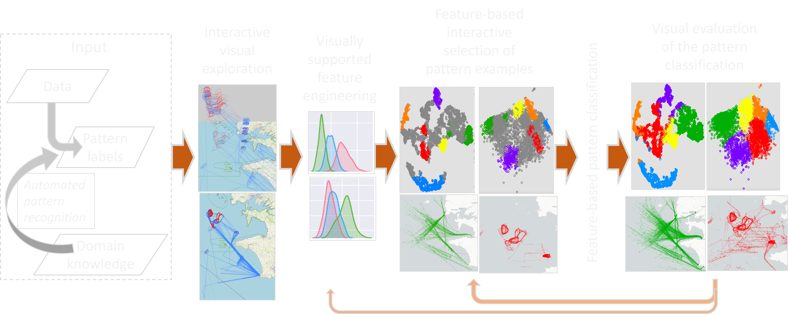
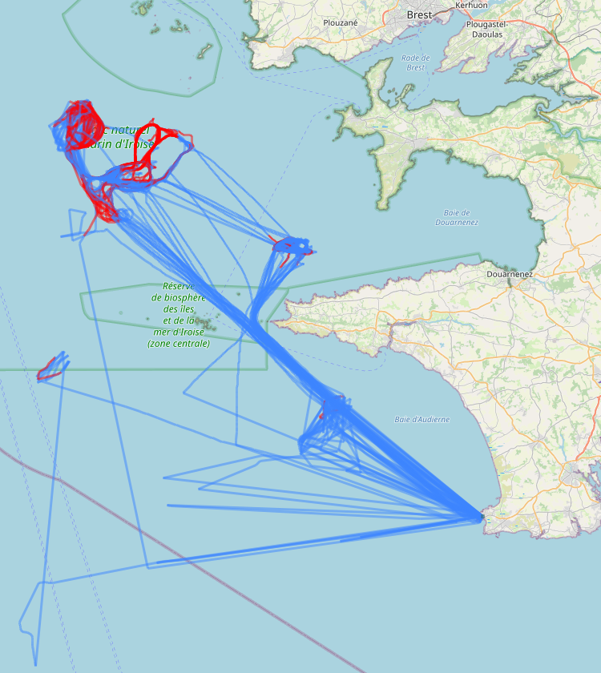
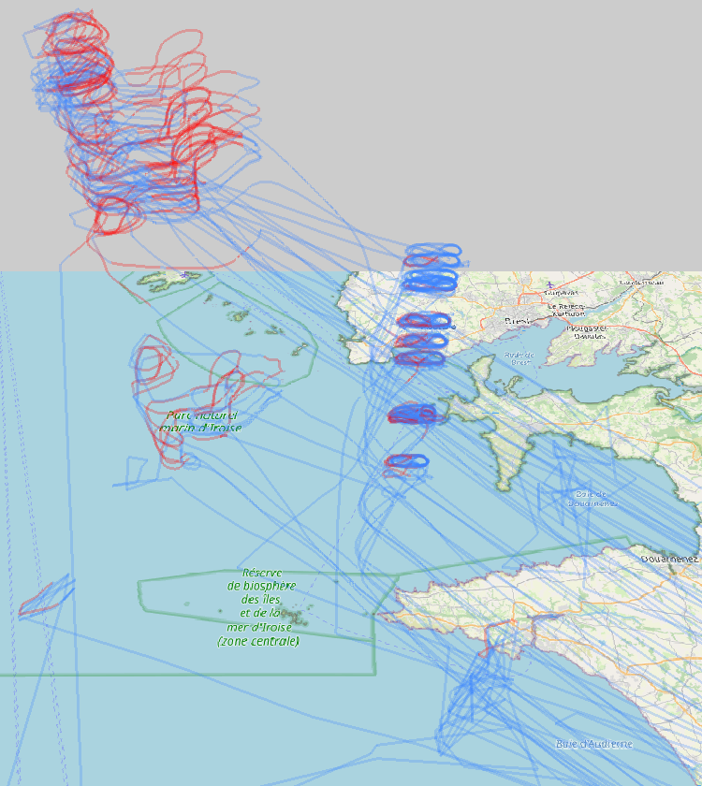
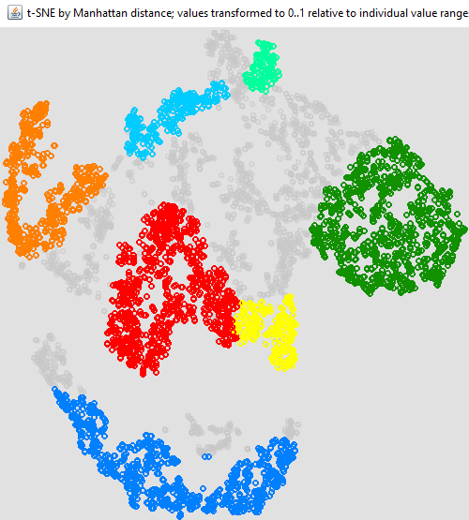
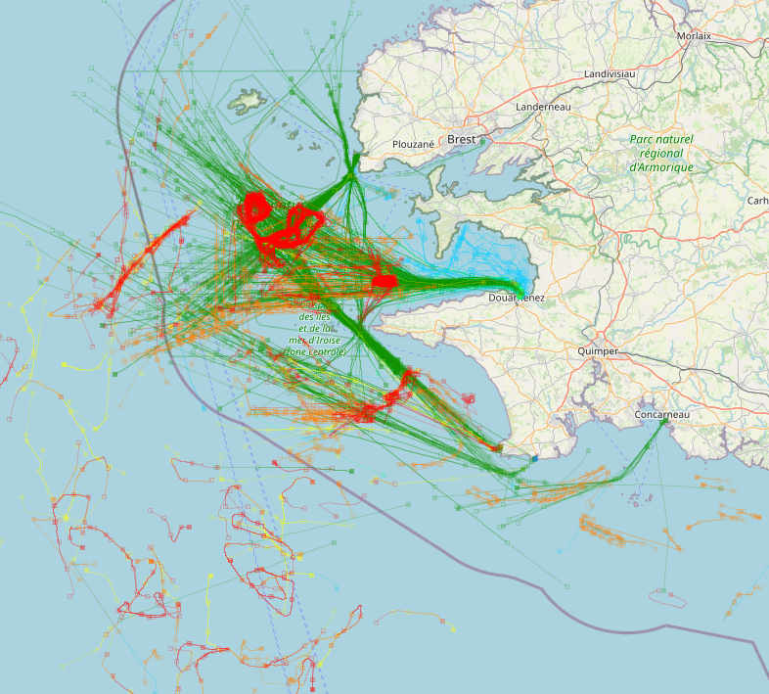
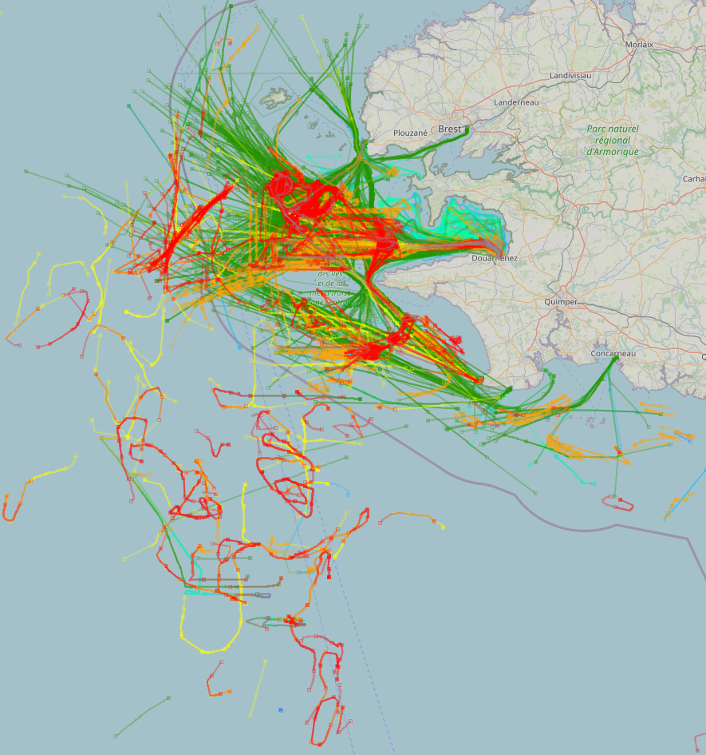
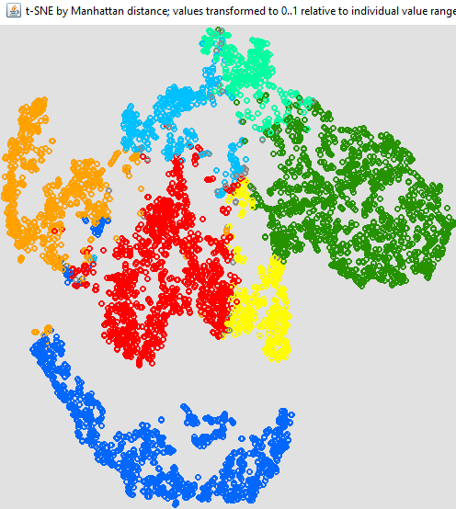
Using VA to enhance recognition of complex movement patterns
Support involvement of expert knowledge in model creation
Leverage human capabilities to recognise patterns in visual representations and interpret the patterns based on domain knowledge

Slide 20
Summary
Support involvement of expert knowledge in model creation
Involvement of human intelligence can significantly improve machine’s capability to detect complex behavioural patterns in movement data.
The improvement is achieved due to overcoming the rigidity in applying machine-oriented pattern definitions.
The key step is abstraction of data within time intervals by defining relevant features to characterise attribute behaviour.
Requires domain knowledge and capability to use various statistical metrics for characterising behaviour.
Visualisation and interaction tools support effective feature engineering and evaluation of classification results.
It appears possible to create a catalogue of recommended features to reflect different aspects of attribute behaviour on a time interval.

Slide 21
Possible research directions in human-centred AI

Slide 22
Learning from experts in the process of model creation
Possible research directions in human-centred AI
Acquisition and use of domain concepts and relationships (particularly, causal)
Learning of domain logic
Learning how to explain

Slide 23
Facilitating model utilisation and adoption
Possible research directions in human-centred AI
Explaining model work and results
Use of domain concepts, relationships, and logic
Human-friendly, in particular, visual presentation of information
Compliance with general human cognitive abilities and limitations
Adaptation to specific user categories (e.g., experts, decision makers, patients, …)
Building trust
Enabling users to explore model behaviour (through interactive visual interfaces)
Personalisation
Enabling and utilisation of users’ feedback

Slide 24
Collaborative human-AI problem solving and decision making
Possible research directions in human-centred AI
Developing models that complement and augment human abilities
Focus on tasks and situations where human experts have difficulties
Avoid replacing humans where they perform well
Support of human-AI collaborative work
Providing convenient visualization and interaction facilities
Support of discourse and mixed initiative
Integration of AI and human contributions
Mimicking human reasoning
Using human-like reasoning in explanation and collaboration

Slide 25
Conclusion
Two sides of human-centred AI:
Make machine intelligence comprehensible and acceptable to a human.
Adapt to human mental models and ways of reasoning.
Respect perceptual and cognitive limitations.
Enhance machine intelligence with human intelligence.
Learn concepts and relationships
Learn solution/decision strategies
Learn how to explain
Enable human-AI communication and collaboration by visual analytics
Data
Context
knowledge
ML
directions
Human
explanations

