Slide 1


ML Solutions for Time Series
Problems
Amal Saadallah

Slide 2
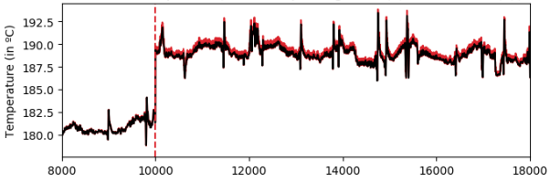
Time Series
General Definition: “A time series is a collection of observations made sequentially through time, whose dynamics is often characterized by short/long period fluctuations (seasonality and cycles) and/or long period direction (trend)”
Observations of a time series X recorded from 1 to T may be denoted by
X_{1:T}= x₁, x₂ ,…,x_{t},…,x_{T} since data are usually collected at discrete points in time.
Observation at time t

Slide 3
Forecasting​
Logistics
Transportation
Retail Grocery
Manufacturing
Energy
& Utilities
Forecasting of shipped packages: workforce planning.
Forecasting of transportation demand: stations' planning and traffic management.
Forecasting of sales during promotions: optimizing warehouses.
Process quality forecasts : improving operational efficiency
Energy load forecasting: better planning and trading strategies.

Slide 4
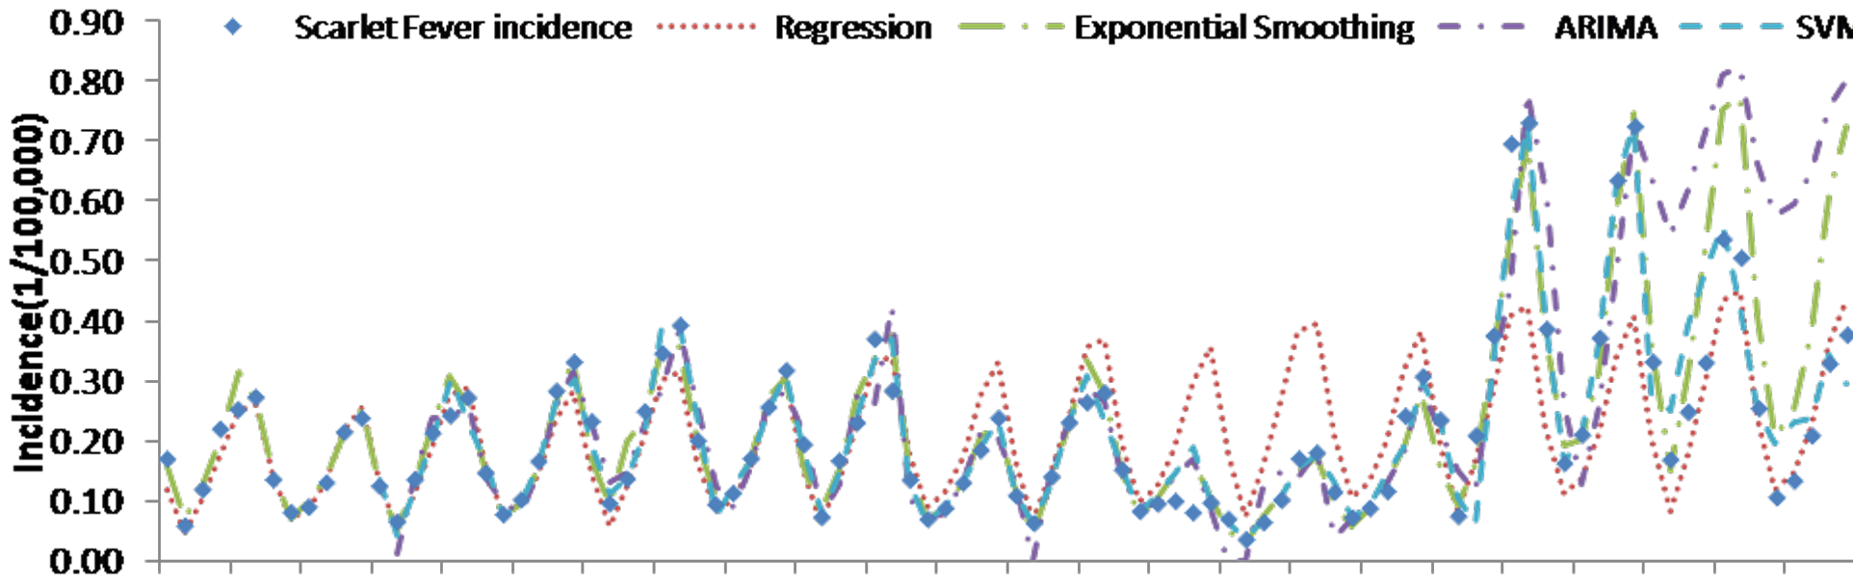
Motivation
NOT ONLY!: None of the existing forecasting models is universally valid for every application.
Forecasting models reveal a time-varying performance over the time series

Slide 5



Motivation
NOT ONLY!: None of the existing forecasting models is universally valid for every application.
Forecasting models reveal a time-varying performance over the time series
  Regions-of-Competence

Slide 6
Motivation
NOT ONLY!: None of the existing forecasting models is universally valid for every application.
Forecasting models reveal a time-varying performance over the time series
  Regions-of-Competence
Online Adaptive model selection is required !

Slide 7
Motivation
NOT ONLY!: None of the existing forecasting models is universally valid for every application.
Forecasting models reveal a time-varying performance over the time series
  Regions-of-Competence
Online Adaptive model selection is required !
There is an increasing need for opting for explainable or easy-to-understand models and learning decisions.

Slide 8
Motivation
NOT ONLY!: None of the existing forecasting models is universally valid for every application.
Forecasting models reveal a time-varying performance over the time series
  Regions-of-Competence
Online Adaptive model selection is required !
There is an increasing need for opting for explainable or easy-to-understand models and learning decisions.
Explainable model selection is also required !

Slide 9
Regions of Competence Computation
DNN specific approaches using gradient-based saliency maps (Saadallah et al.,2021, Saadallah et al.,2022, Saadallah and Jackob, 2023)

Slide 10
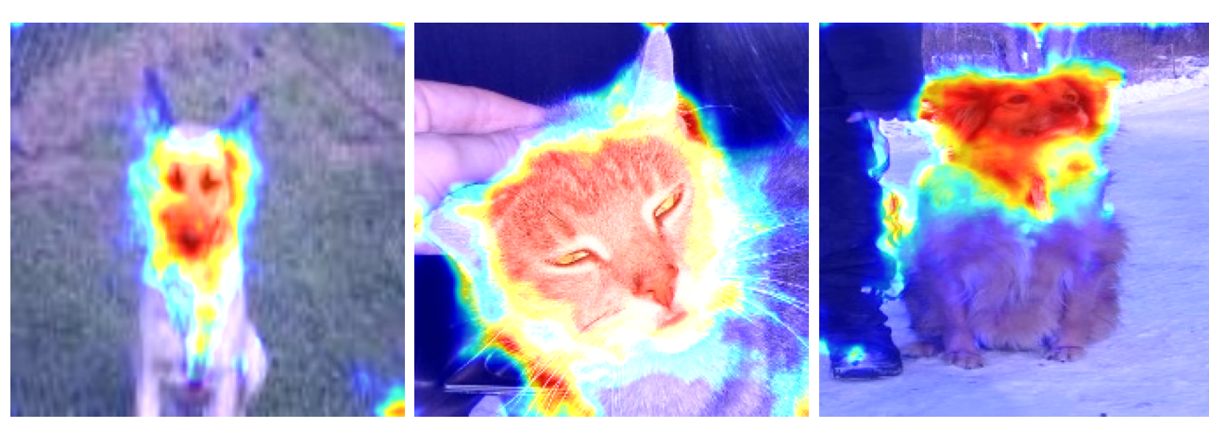
Regions of Competence Computation
DNN specific approaches using gradient-based saliency maps (Saadallah et al.,2021, Saadallah et al.,2022, Saadallah and Jackob, 2023)
  => Adaptation of Grad-CAM

Slide 11
Regions of Competence Computation
DNN specific approaches using gradient-based saliency maps (Saadallah et al.,2021, Saadallah et al.,2022, Saadallah and Jackob, 2023)
  => Adaptation of Grad-CAM

Slide 12
Regions of Competence Computation
DNN specific approaches using gradient-based saliency maps (Saadallah et al.,2021, Saadallah et al.,2022, Saadallah and Jackob, 2023)
  => Adaptation of Grad-CAM
Model-agnostic approach using adaptive clustering (Saadallah 2023)

Slide 13
Regions of Competence Computation
DNN specific approaches using gradient-based saliency maps (Saadallah et al.,2021, Saadallah et al.,2022, Saadallah and Jackob, 2023)
  => Adaptation of Grad-CAM
Model-agnostic approach using adaptive clustering (Saadallah 2023)
Tree-specific approach using Tree-shapely values (Saadallah and Jackob, 2023)

Slide 14
Explainability using Regions of Competence

Slide 15
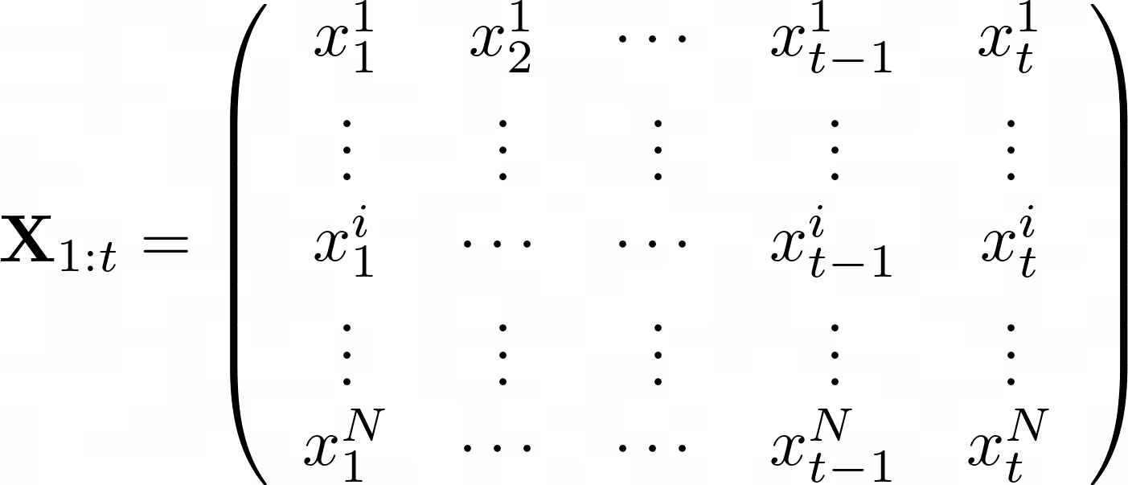
Multivariate Time Series Forecasting
Temporal dimension
Input time series
Predict the value of X^{i} at t+1
Target time series
Spatial dimension
Time-window of observations

Slide 16

Multivariate Time Series Forecasting
Temporal dimension
Input time series
Predict the value of X^{i} at t+1
Target time series
Spatial dimension
Time-window of observations
Time-evolving nature of the time series and the dependence structure between its variables.
Forecasting models’ performance is time-dependent.

Slide 17
Multivariate Time Series Forecasting
Temporal dimension
Input time series
Predict the value of X^{i} at t+1
Target time series
Spatial dimension
Time-window of observations
Time-evolving nature of the time series and the dependence structure between its variables.
Forecasting models’ performance is time-dependent.
Online adaptive input MTS variables selection.
Online model adaptation.
Task automation.

Slide 18
Concluding Remarks
Time series analysis for physics:
  Automated real-time time series features analysis and extraction
  Time series forecasting: adaptive and explainable
  Multivariate time series analysis

