Slide 1

Experimental particle physics
Johannes Albrecht (TU Dortmund & Lamarr)
29.11.2023
Many references to B. Mitreska and Q. Führing, Lamarr meeting 8.11.23

Slide 2
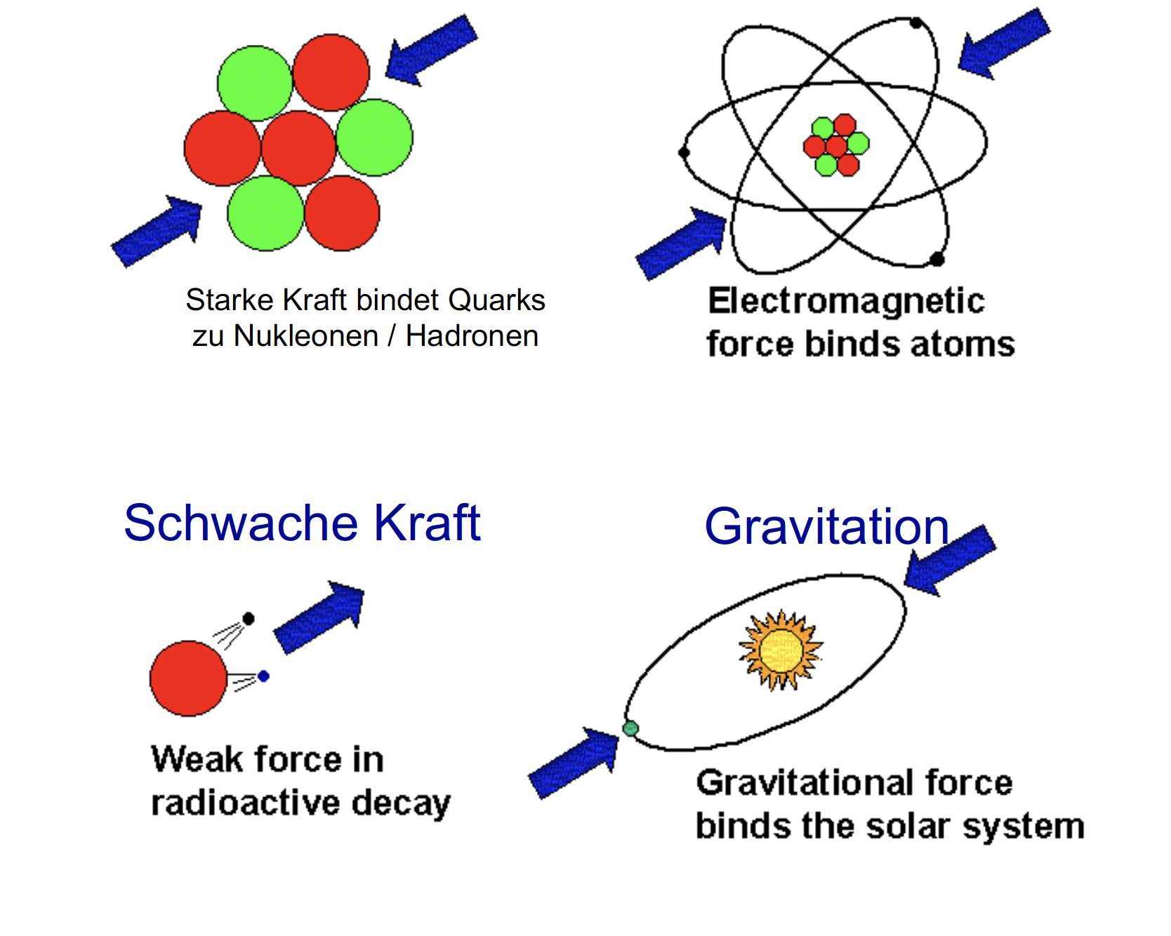
Modern particle physics
We know of four fundamental forces of nature
Strong force (QCD)
Electrodynamics
Color
Well understood
Strong force binds quarks to nucleons / hadrons
Weak force
Gravity
Can only be studied on large scales
(Astro- [particle] physics, Gravitational waves)
Flavor
Weak force in
radioactive decay
Strong and weak force need to be studied jointly

Slide 3
Fundamental Physics
Visible
universe
10²⁷m
Quarks
<10⁻¹⁹m
1 000 000 000 000 000 000 000 000 000 meter
0,000 000 000 000 000 000 01 meter
proton
neutron
Atom
<10⁻¹⁰m

Slide 4
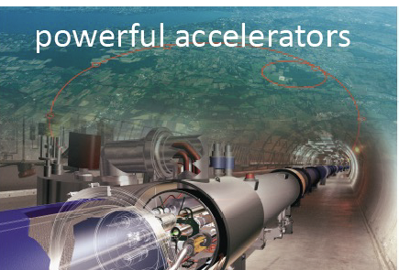
Fundamental Physics
Visible
universe
10²⁷m
Visible with eyes
Quarks
<10⁻¹⁹m
1 000 000 000 000 000 000 000 000 000 meter
0,000 000 000 000 000 000 01 meter
proton
neutron
Atom
<10⁻¹⁰m

Slide 5
Fundamental Physics
Accessible at colliders
1 000 000 000 000 000 000 000 000 000 meter
0,000 000 000 000 000 000 01 meter
Quark decays
Hadrons
(bound states)

Slide 6
The Standard Model of Particle Physics
Fermions
Bosons
u
up
c
charm
t
top
γ
photon
W±
W-boson
Force carriers
Spin ½
Force carriers
Quarks
s
strange
b
beauty
Spin 1
“Vector”
d
down
Z⁰
Z-boson
g
gluon
ν_{e}
electron
Neutrino
ν_{μ}
muon
Neutrino
ν_{τ}
tau
Neutrino
Z’?
Z’-boson
Lq?
Leptoquark
Spin 1 or 0
Spin ½
e⁻
electron
μ⁻
muon
τ⁻
tau
Leptons
H⁰
Higgs
boson
A⁰?
Multiple Higgs
Spin 0
“Scalar”
Open questions of the SM
  Cosmological observations: dark matter
  & matter-antimatter asymmetry
  Hierarchy of masses & couplings
Extended theories come with new heavy particles
How can we discover these extensions?
Notes:
Z' as the new force carrier of an additional U(1) gauge symmetry
Stephie:
Ist es wirklich dass proposed new particles solve questions
oder eher dass Theorien die die Fragen lösen neue Teilchen vorhersagen?
Extended theories come with new (heavy) particles.

Slide 7
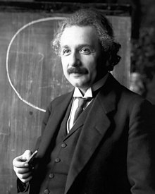

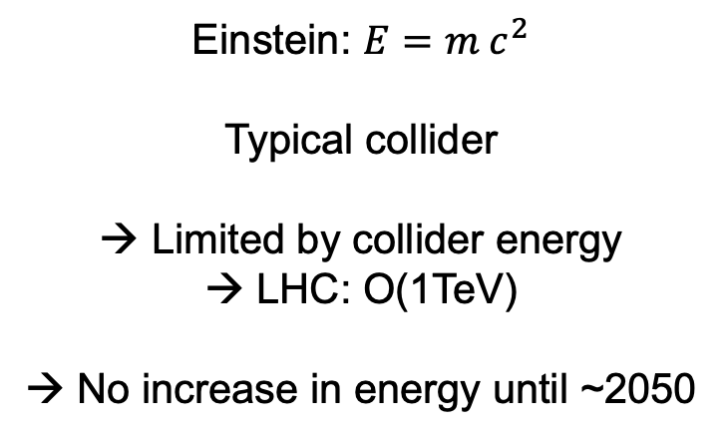
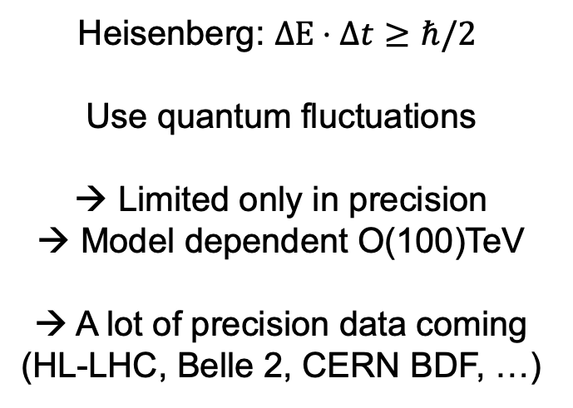
Einstein and Heisenberg
Einstein: $E=m c^{2}$
Typical collider
→ Limited by collider energy
→ LHC: O(1TeV)
→ No increase in energy until ~2050
Heisenberg: $ΔE⋅Δt≥ℏ/2$
Use quantum fluctuations
→ Limited only in precision
→ Model dependent O(100)TeV
→ A lot of precision data coming
(HL-LHC, Belle 2, CERN BDF, …)

Slide 8
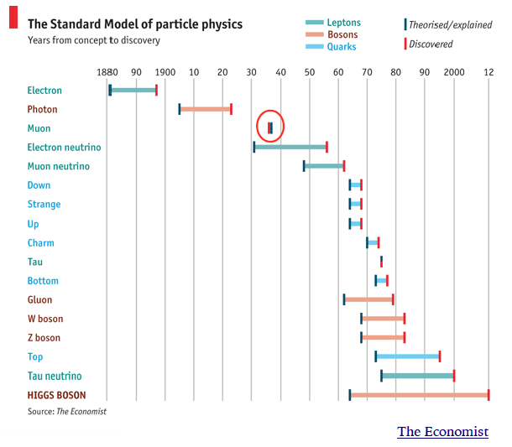
Expected and unexpected discoveries

Slide 9
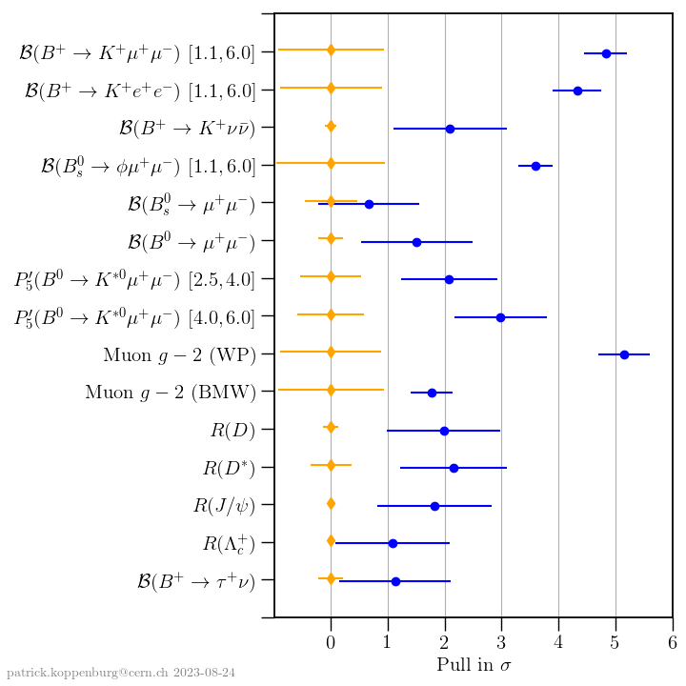
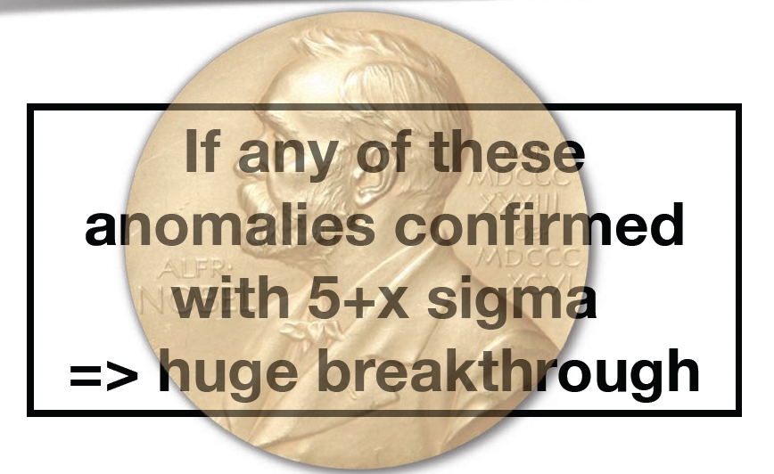
Where are we? Anomalies
So far no clear 5σ sigma deviation
Falsifying anomalies is prime task for flavour-physicists
b → s l⁺l⁻
b → c τ ν

Slide 10
Uni Bonn
KIT

Slide 11
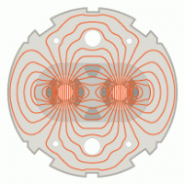

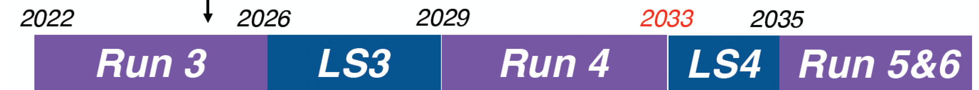

Beschleuniger, Experimente und Zeitskalen
2033
2041
LS2
LS2 (2019-21)
ALICE Upgrade
LHCb Upgrade 1
LS3 (2025-27)
HL-LHC
ATLAS Phase 2
CMS Phase 2
LS4 (2033-35)
ALICE 3 upgrade
LHCb Upgrade II
2022 2024 2028 2030
LS1
Run 2
LS2
Run 2
Disclaimer: SuperKEKB Zeitplan nicht offiziell
Notes:
einen festen Zeitplan für LS2 von SuperKEKB gibt es noch nicht, aber ein mögliches Szenario ist auf https://www-superkekb.kek.jp/Luminosity_projection.html dargestellt. LS1 hat Mitte 2022 angefangen, Physics Run2 wird ab 2024 laufen. LS2 kann man vielleicht ab 2028 für zwei Jahre eintragen, aber wie gesagt kann sich das noch ändern. Run3 ist dann vermutlich für ein paar Jahre bis wir 50/ab erreicht haben.

Slide 12
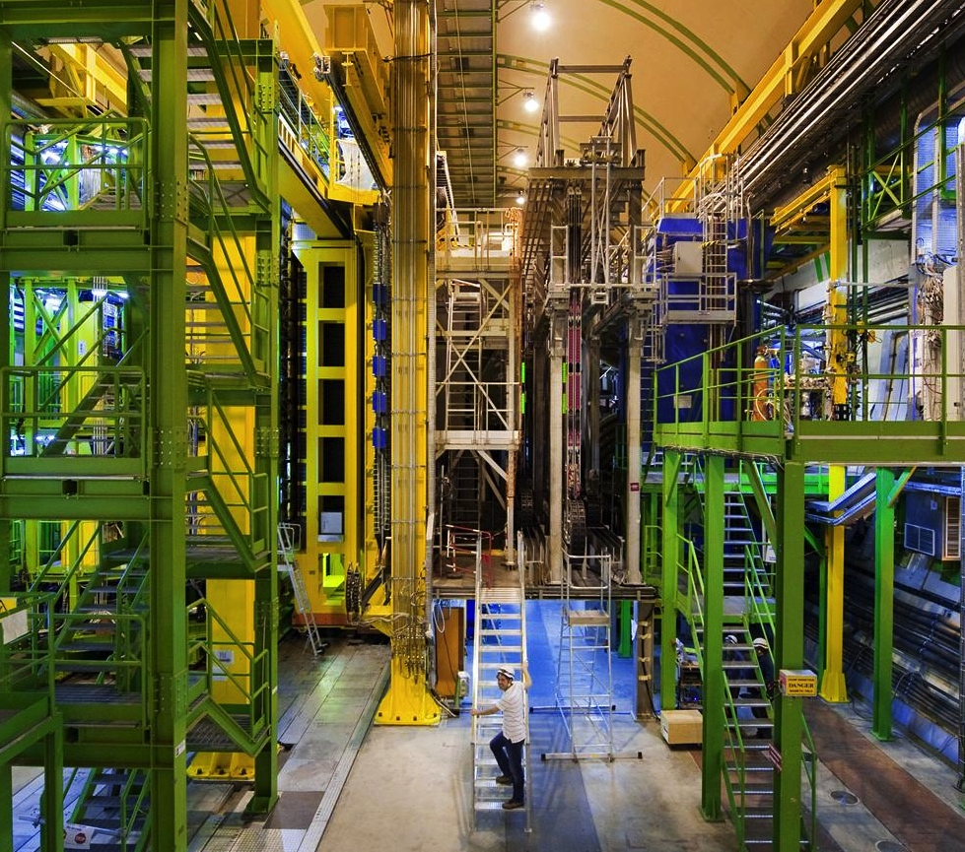
The LHCb Detector

Slide 13
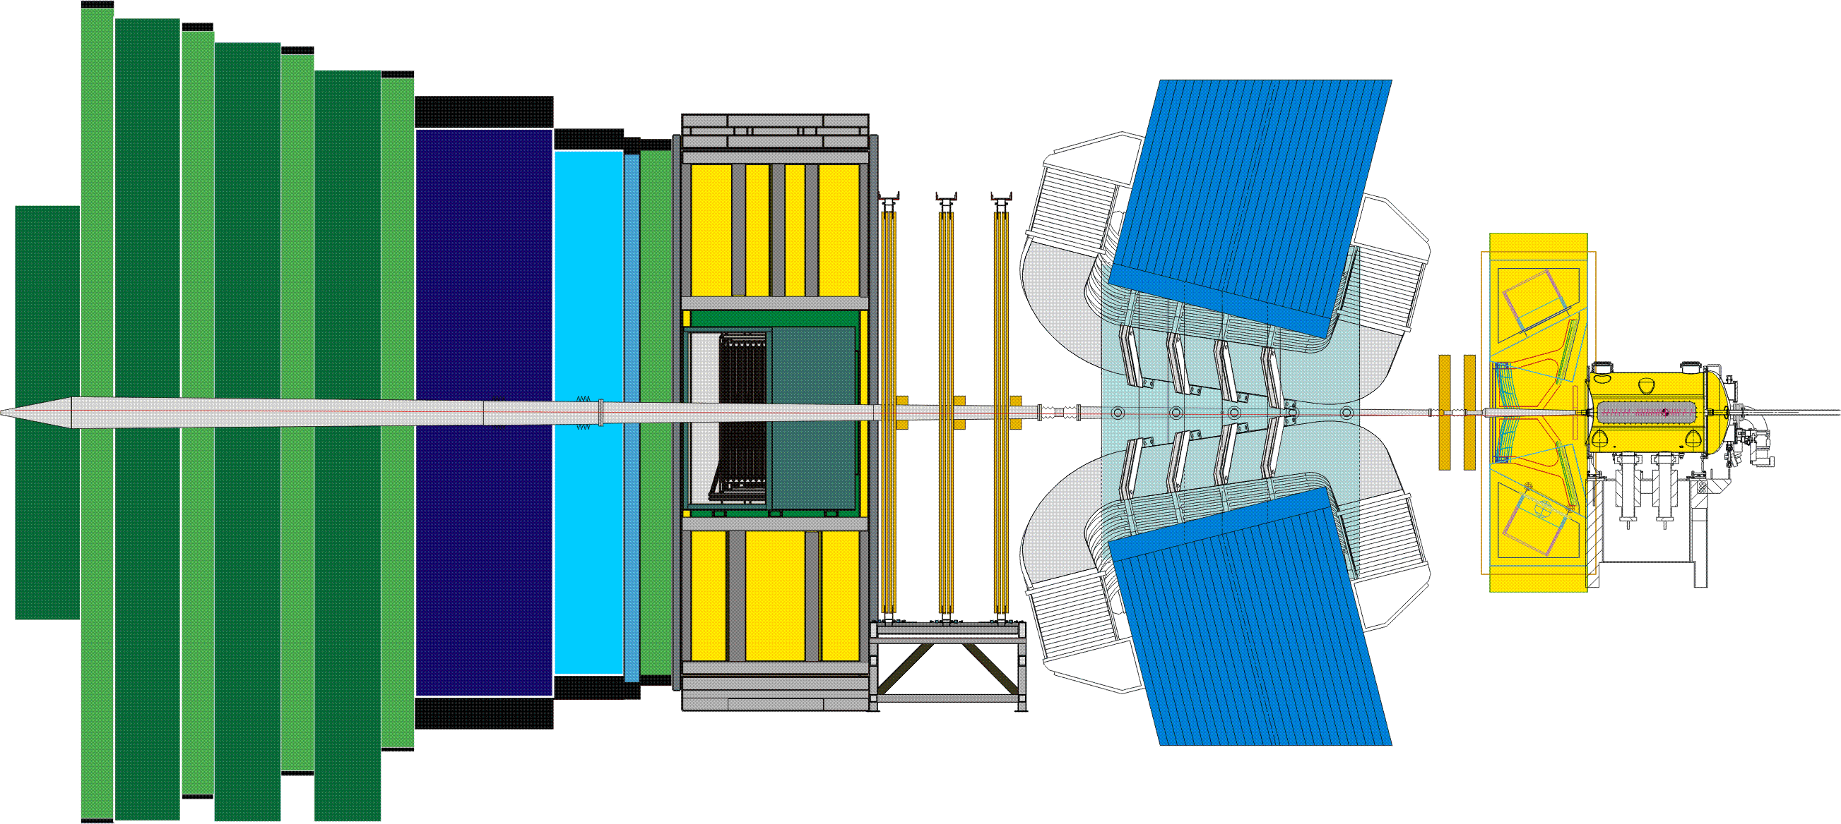
The LHCb Detector

Slide 14
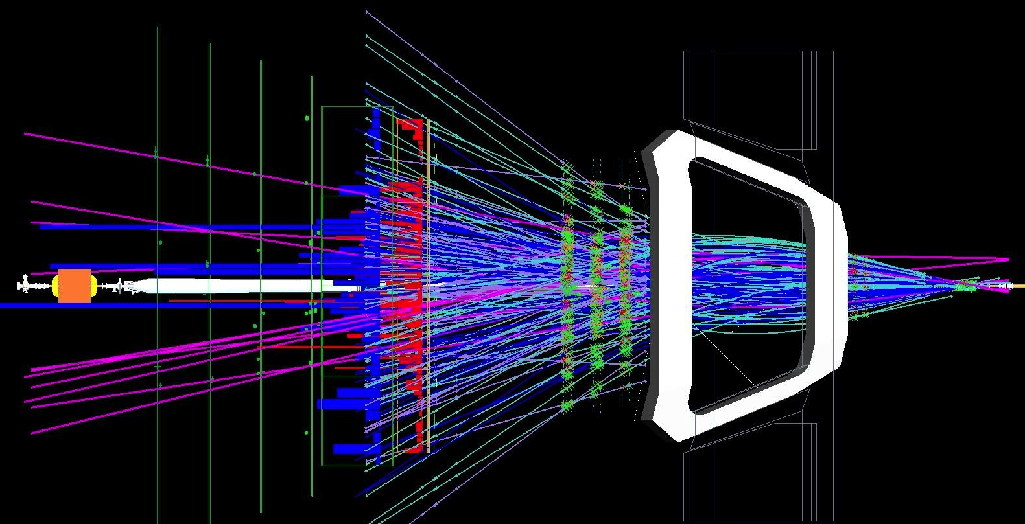
The LHCb Detector
23 sep 2010 19:49:24
Run 79646 Event 143858637

Slide 15
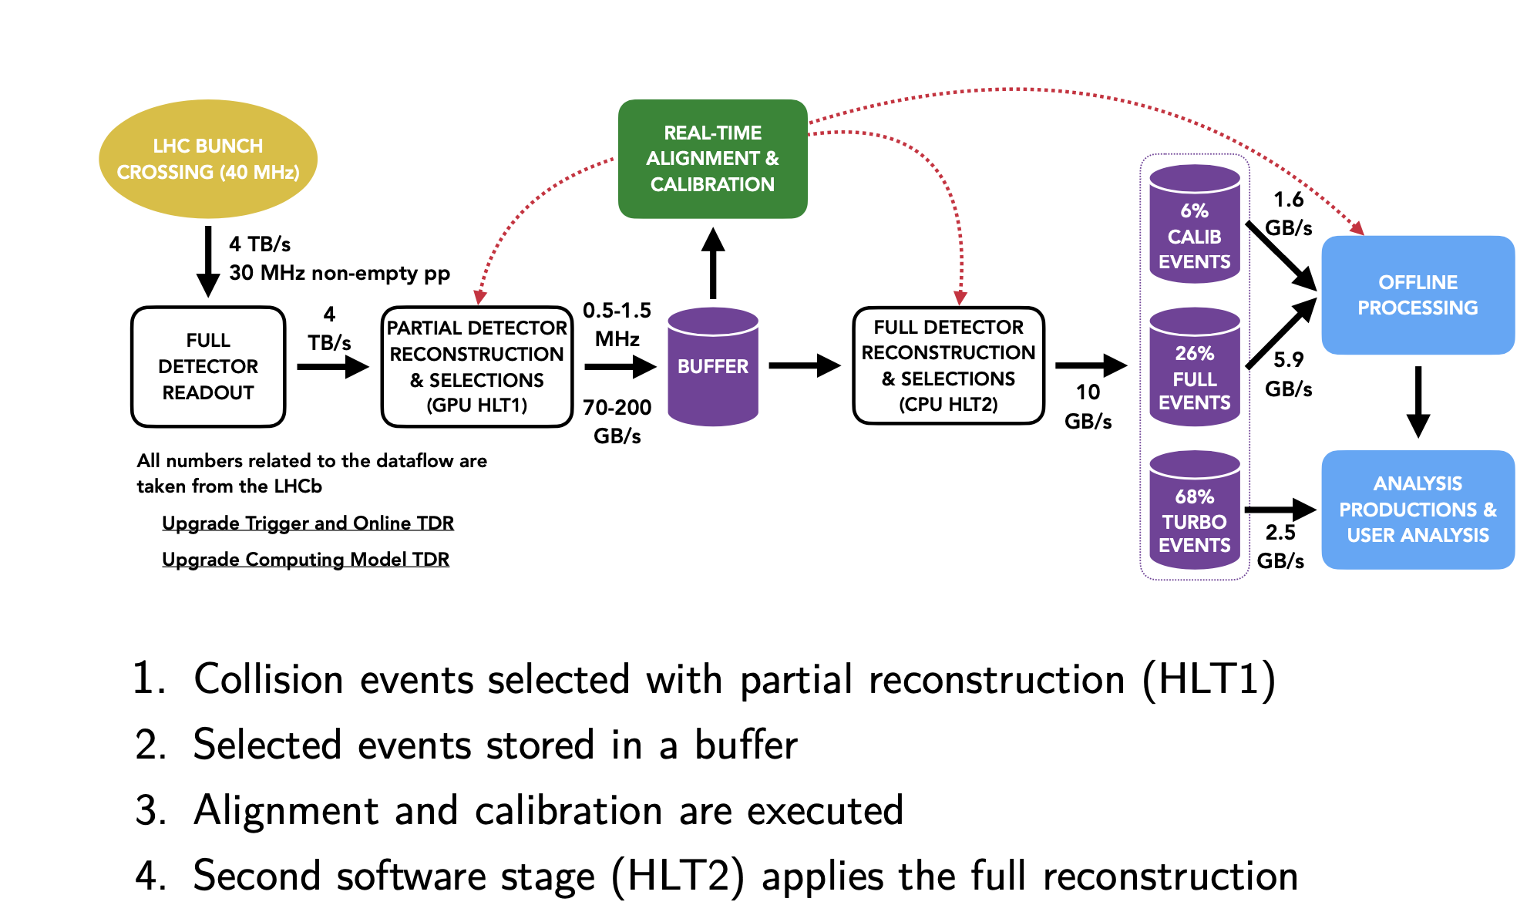
Data collection: „real time“ filtering
LHCb gets 4TB/s to process, for ~10⁷s year, for ~30 years

Slide 16
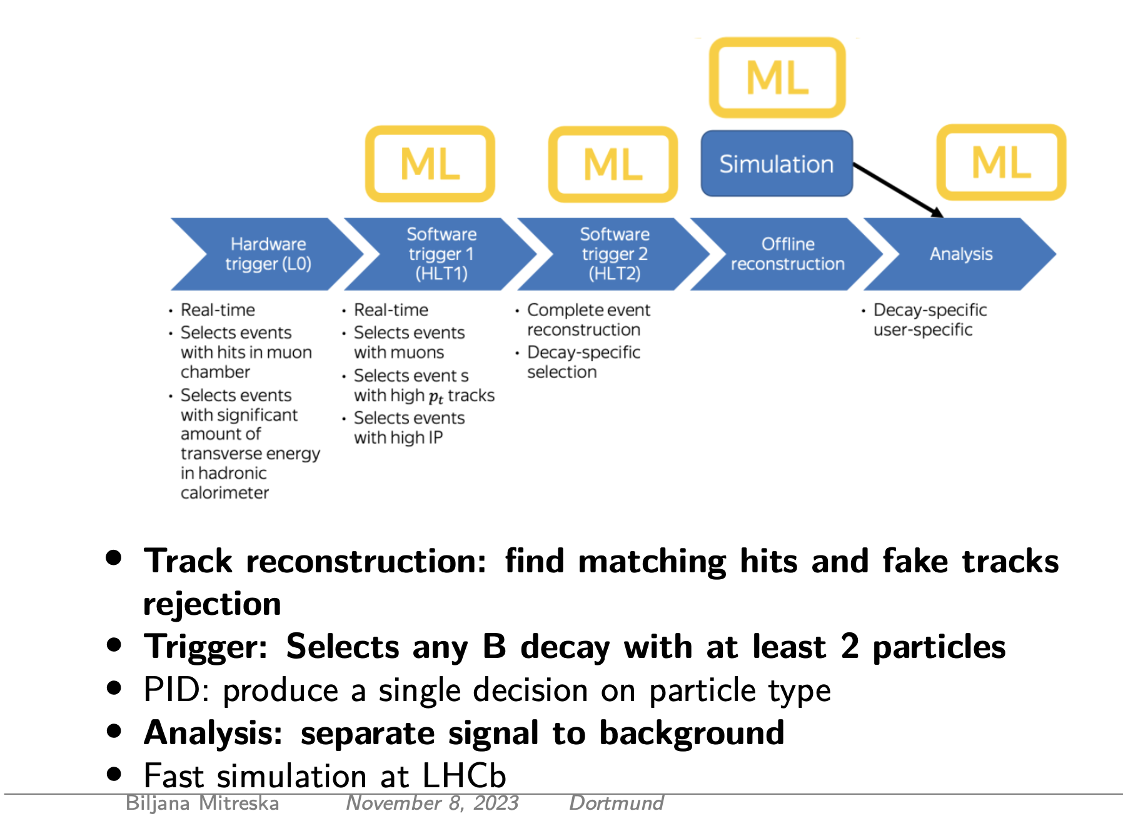
The physics objective: case for machine learning

Slide 17
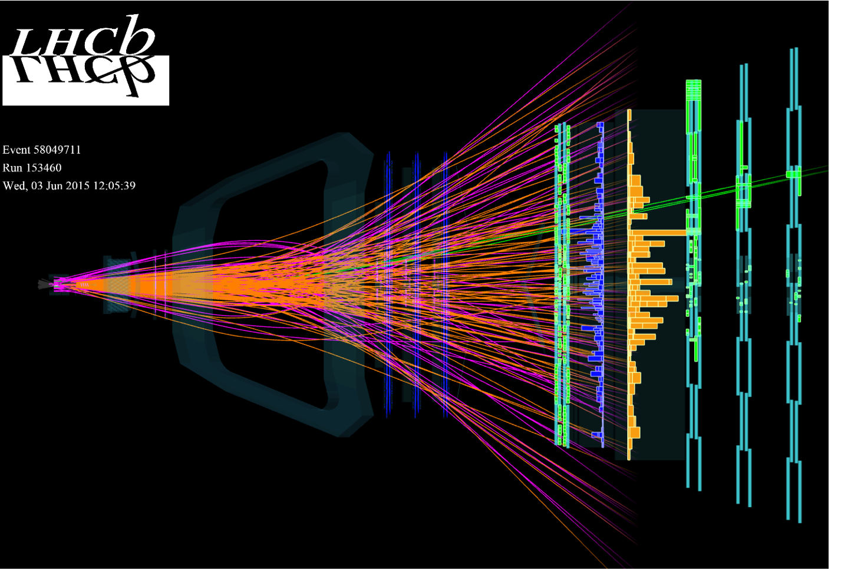
Detector images
„Event“, rate: 30MHz
Intersting computationsl problem: combine ~10.000 single measurement points to particle hypotheses to (2-6) signal candidates

Slide 18
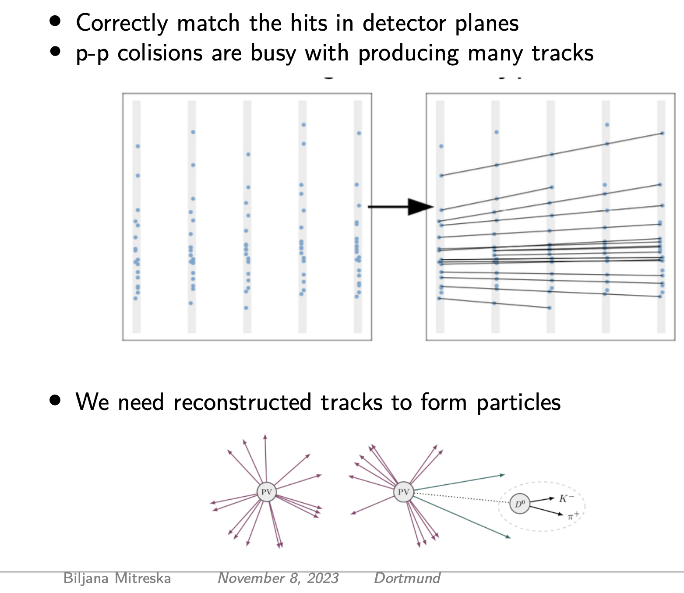
Track and vertex reconstruction
Many problems where expert knowledge might be able to help:
Pattern recognition
Parameter estimate
Ring finding
Anomaly testeing
System architecture, hybrid optimization
(Volume: 400 nvidia A5000 GPUs + O(70k) Intel E5-2630 equivalent physical cores, 30PB disc, 1-2M network cost )
Fast and efficient candidate selection
~signal fraction up to 1:10¹⁰
…

Slide 19
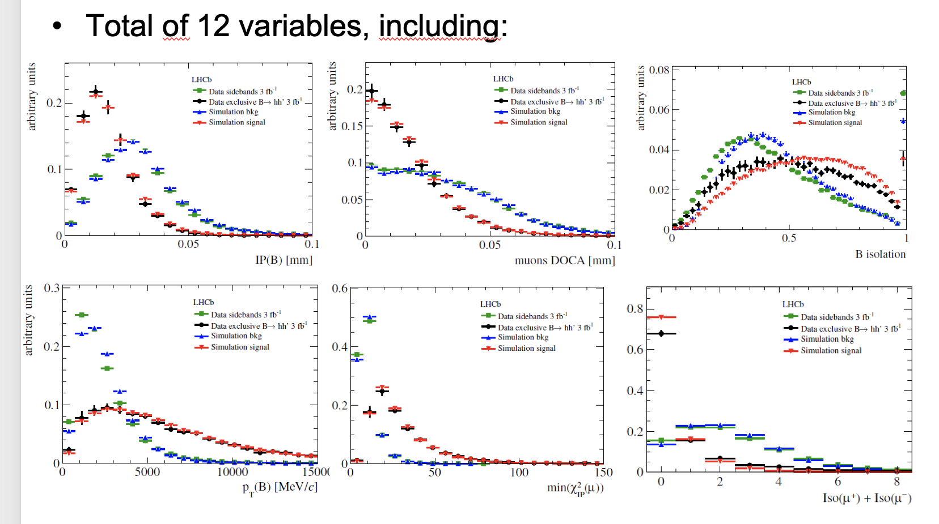
Analysis: signal separation
Typical: many variables, all with some separation power
Combine variables in clasifier (BDT, NN, ..)
Problem: simulation & signal proxy
Put some thought in Labelling ?
Many intersting problems:
  Simulation: enourmous ressources, event generation (learning possible?), detector response, etc
  Smart use of entire event?
  Hypothesis based analysis
  → learned Standard Model ?

Slide 20
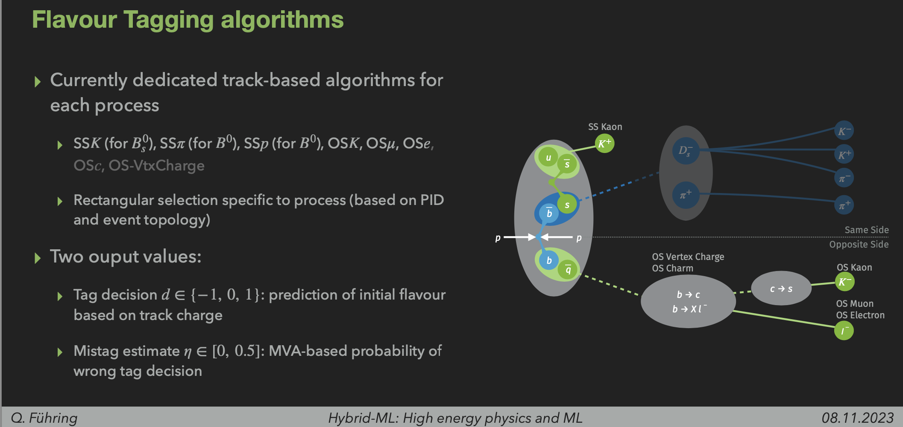
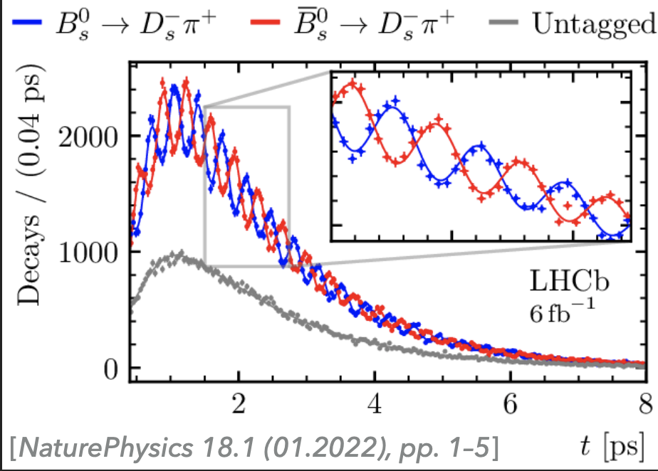
Flavor Tagging: a whole playground
Limits performance of analysis, currently, we loose factor 20
Complex, hypothesis based analysis → can we do better?
Inclusive tagger in development (since many years … )
Differences: simulation-data known, but complex
  Often recovered by multivariate reweighting
  Alternative approaches to be studied (e.g. Domain Adaptation)
Work in progress (Führing, Bunse, Pfahler)

Slide 21
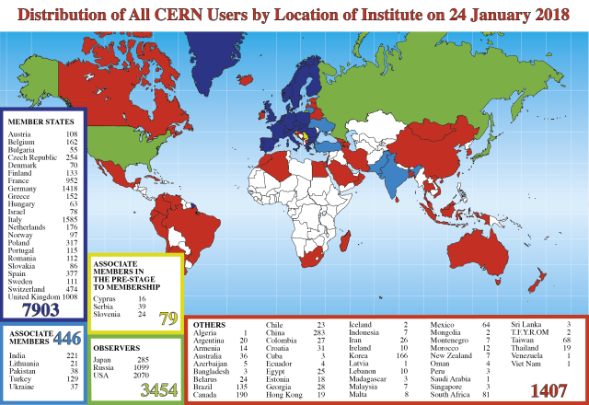
Summary
Particle Physics: Experimental situation very interesting
  Entire community joined forces at one
  accelerator center at a time
  → extremely focussed field
  We have 10 years of LHC data and will
  collect another 20
  → huge dataset to exploit optimally
Modern Particle Physics is (in a part) data science
  Process 4TB/s of data in „real time“
  Many hypothesis based approaches, often optimal, sometimes not?
  Better access to data in any way has large potential
Particle physicsts are not (entirely) naive
  No quick solutions, joint projects needed and started within Lamarr,
  more collaborations welcome

Slide 22














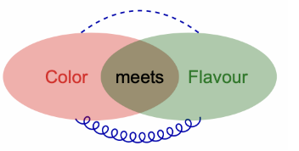
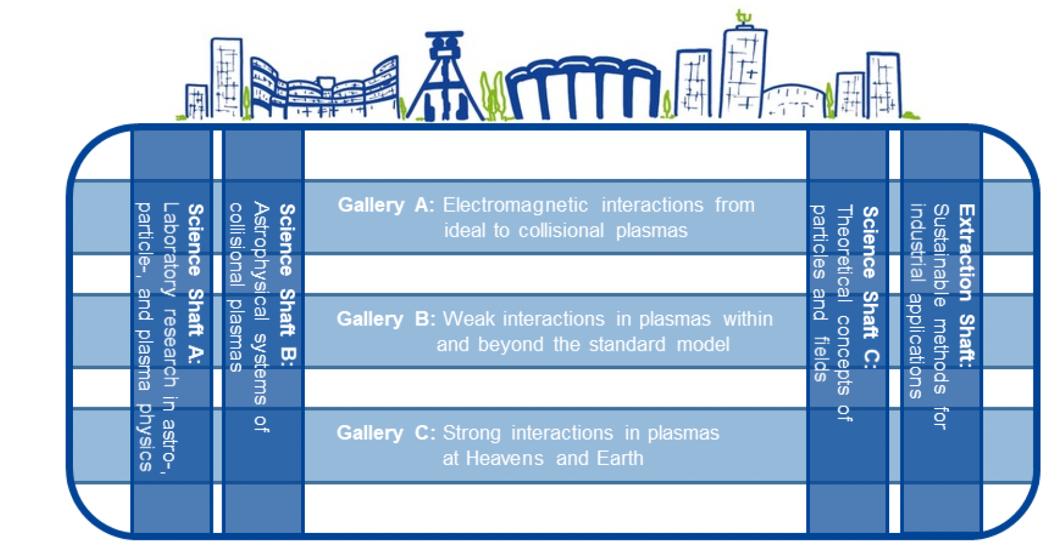
Stamp Collection / Danksagung and Fördergeber
There is still some space left…

Slide 23
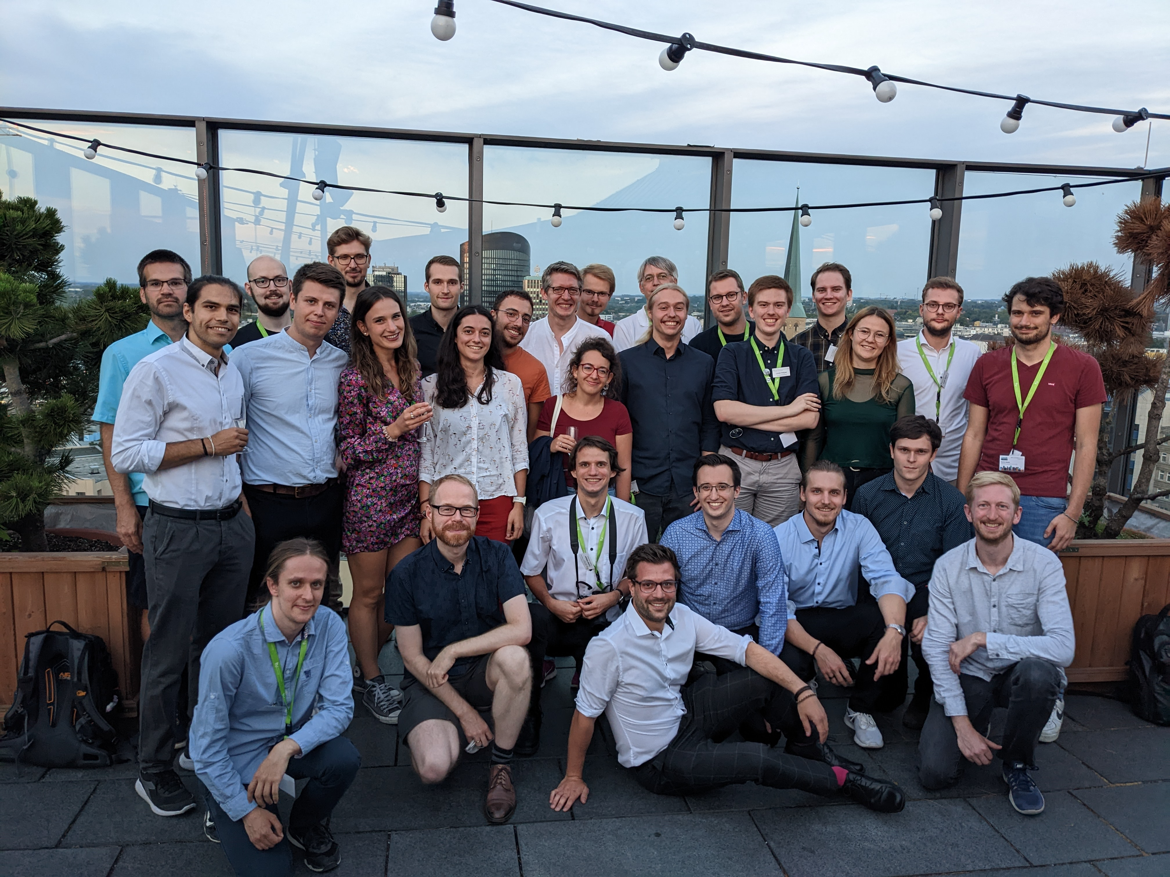
Many thanks to my group!
Orgateam LHCb Woche, 09/2022

Slide 24

Clearly influenced by M. Charles

