Slide 1
Unfolding the neutrino energy spectrum
Leonora Kardum
on behalf of Lehrstuhl für Experimentelle Physik 5, TU Dortmund
SFB 1491 Kick-off meeting
June 2022

Slide 2
Why neutrinos?
Small but nonvanishing mass
No charge
Not susceptible to the strong force
Interact only via weak force
Can travel galactic distances without changing their direction
Second most abundant particle in the Universe
Over 300 neutrinos per cubic centimeter
Flavor changing (oscillating)
Many unresolved questions

Slide 3
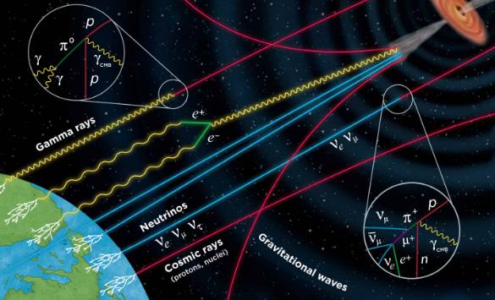
Neutrino sources
Many different neutrino sources, either terrestrial or astrophysical
The energy of a neutrino points to the means of its production
Image credit: GRAND (Giant Radio Array for Neutrino Detection)

Slide 4
Neutrino sources
cosmic neutrino background (CNB)
nuclear processes (solar, supernova...)
cosmic rays collision with Earth's atmosphere
extreme objects (neutron stars...)
cosmogenic neutrinos
low energy
high energy
Detection in IceCube
very high energy
ultra high energy

Slide 5
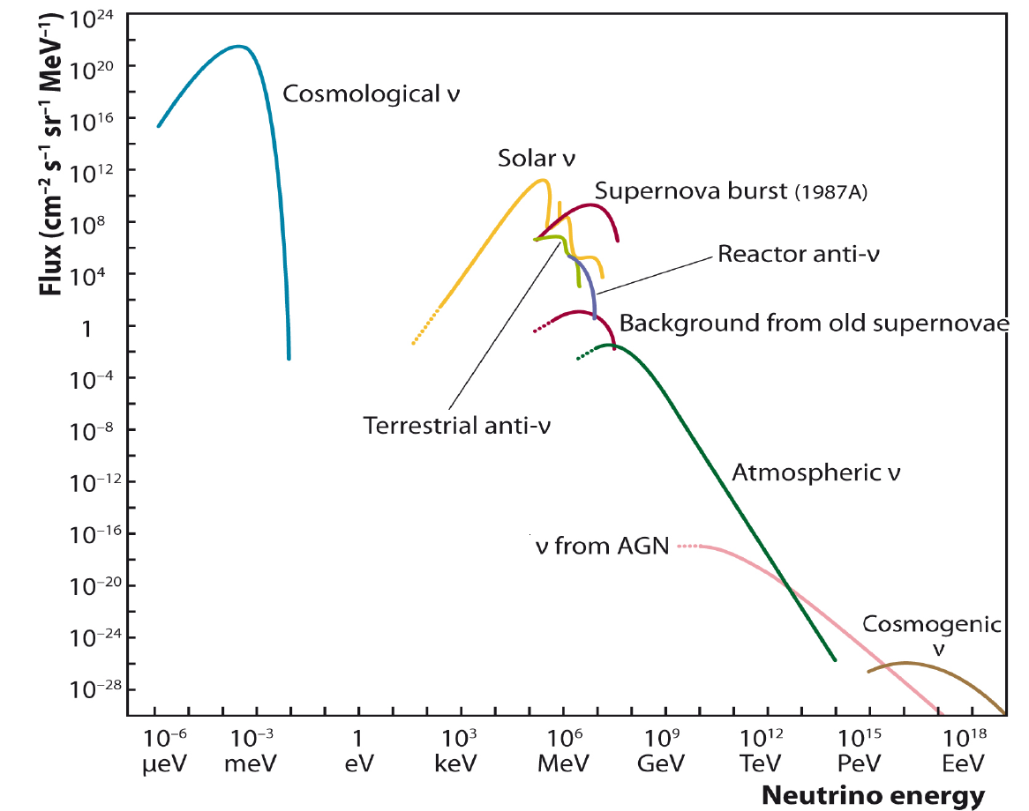

Slide 6
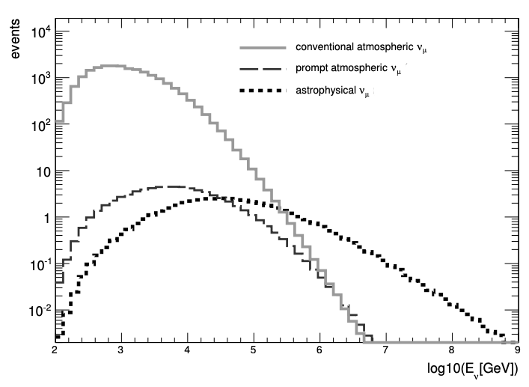
Aartsen, M.G. et al. (2017). Astrophysical Neutrinos and Cosmic Rays Observed by IceCube. Advances in Space Research. 62. 10.1016/j.asr.2017.05.030.
Schukraft, A. (2013). A view of prompt atmospheric neutrinos with IceCube. Nuclear Physics B (Proceedings Supplements) (2013), pp. 266-268

Slide 7
Detection in
IceCube

Slide 8
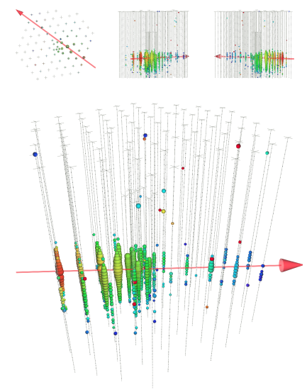
Detection in
IceCube

Slide 9
Detection in
IceCube
Energy smearing gets progressively strong with raising energy in the region of interest

Slide 10
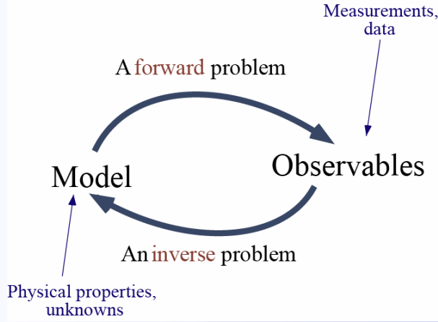
What is Unfolding?
To understand Unfolding, first we need to define Inverse problems:
Detection process
Background
Observables
Property of interest
Image credit: Research School of Earth Sciences, Australian National University

Slide 11
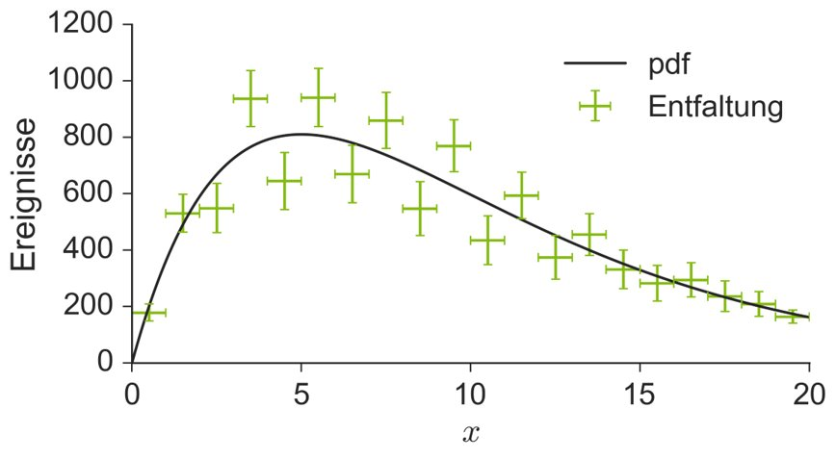
What is Unfolding?
To understand Unfolding, first we need to define Inverse problems:
Truth
Inversion
Leads to large uncertainties if the problem is ill-conditioned!
No events
Credit: Prof. Dr. Dr. Wolfgang Rhode
Statistische Methoden der Datenanalyse

Slide 12
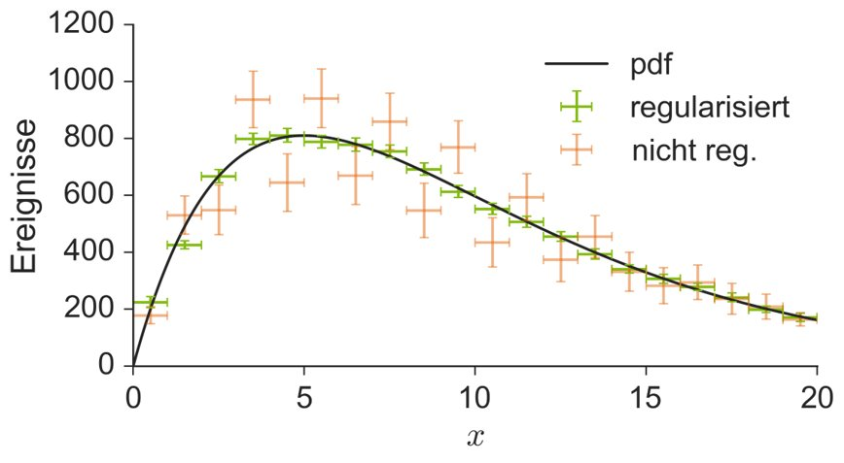
What is Unfolding?
To understand Unfolding, first we need to define Inverse problems:
Truth
Reg. Unfolding
Inversion
Leads to large uncertainties if the problem is ill-conditioned!
No events
Regularization is required!
Credit: Prof. Dr. Dr. Wolfgang Rhode
Statistische Methoden der Datenanalyse

Slide 13
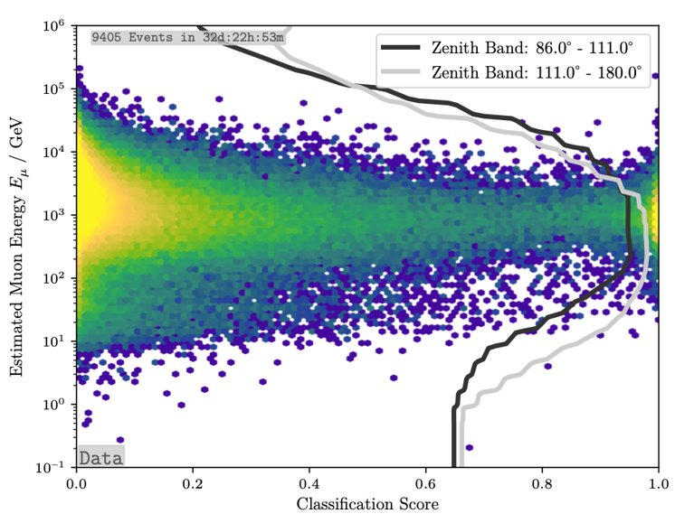
What is Unfolding?
Special attention is given to Sample cleaning (so the Background dropping can be justified)
Sample with purity of 99.7% was achieved with our approach

Slide 14
What is Unfolding?
Two approaches to Unfolding:
Poisson Likelihood Unfolding
Iterative probabilistic Unfolding
funfolding
Dortmund Spectrum Estimation Algorithm (DSEA+)

Slide 15
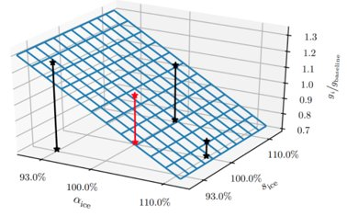
funfolding
Systematics:
Likelihood based Unfolding:

Slide 16
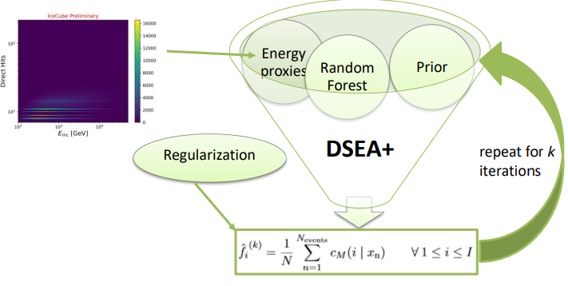
Dortmund Spectrum Estimation Algorithm (DSEA+)

Slide 17
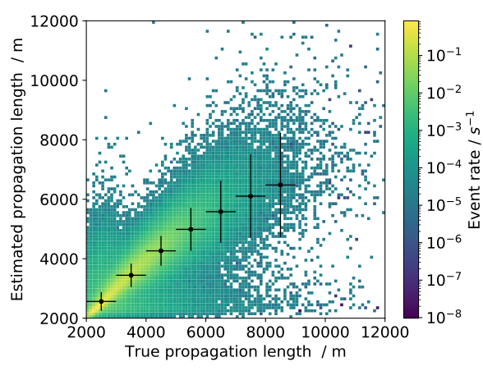
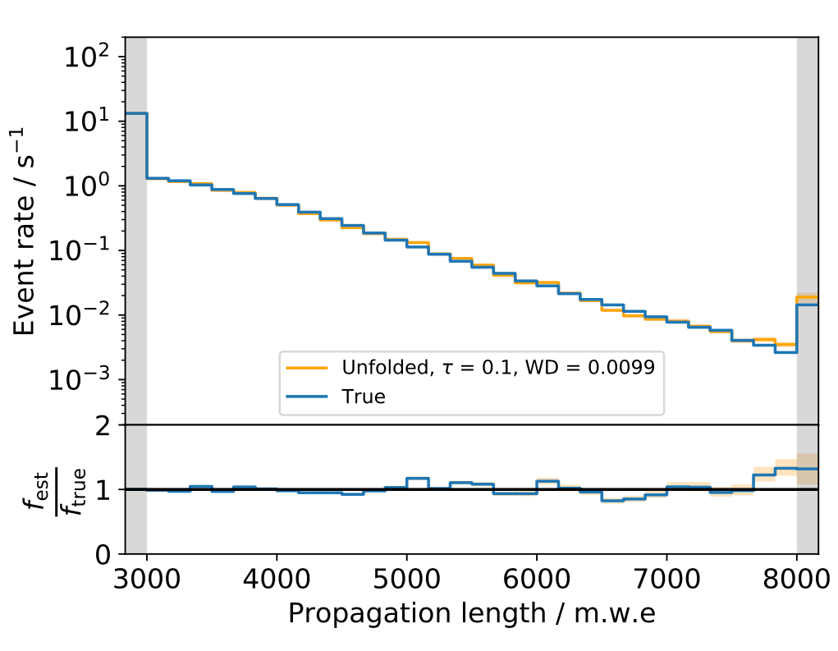
What is Unfolding?
Different approaches to Unfolding based on the chosen Proxy:
e.g. Stopping Muon Unfolding

Slide 18
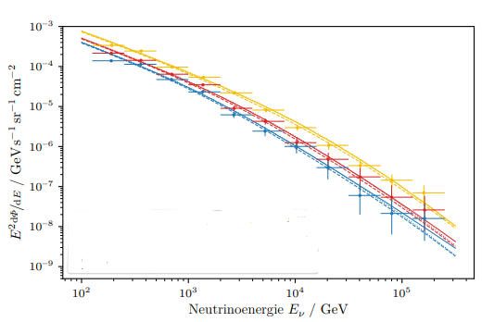
Zenith dependance
Unfolding in different zenith bands can unveil the expected flux dependance to zenith degree

Slide 19
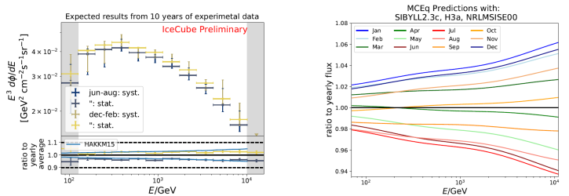
Seasonal variations

Slide 20
Conclusion
Model independent flux estimation
Zenith dependance
Model independent seasonal variations
Unfolding different target variables
What's next?

Slide 21
Thank you for your attention!
Leonora Kardum
on behalf of Lehrstuhl für Experimentelle Physik 5, TU Dortmund
SFB 1491 Kick-off meeting
June 2022

